Slide 1
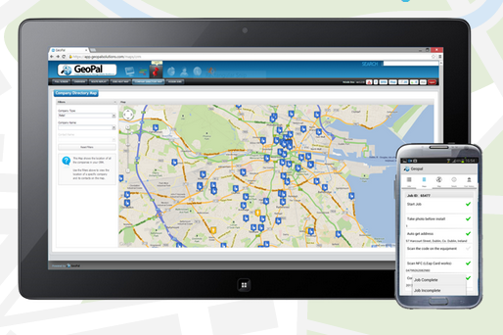
What is GeoPal
GeoPal is cloud service and mobile app for companies that need to manage a field based workforce and assets.
Companies use GeoPal to increase operational compliance and efficiencies by analysing and acting in real time on the flow of information between the back office and the field workforce.

Slide 2
Agenda
Short Corporate Overview
Value Proposition
Problems we solve
Platform overview
Differentiators
General Features
Demo
  IoT/M2M Alarm on Un-manned pump station (21 Steps)
  Water meter installation and Anti-fraud systems (Meter Fraud Check – 62 Steps )
  Vehicle Inspection Report (Vehicle Check – 16 steps)

Slide 3
Corporate Overview

Slide 4
The Founders

Slide 5
Infogram
Continents
5
Workflows
Completed
3,000,000 +
Years Dev
6
Emails and SMS
2,000,000 +
Offices
3
Verticlas
11
Workflow Steps 2015
400,000,000
Workflow Steps 2016
100,000,000,000
Languages
2

Slide 6

Selection of Existing Partners

Slide 7




































Some of our Customers

Slide 8




Some of our new Opportunities

Slide 9

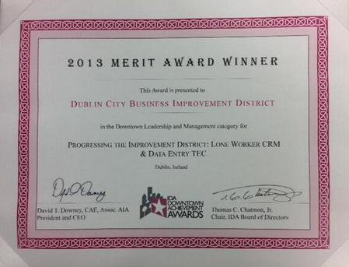
Award winning
The winner here was Geopal Solutions and the company's intelligent dispatch system that has so far received a very positive response from many customers. GeoPal's IoT-enabled mobility platform and intelligent job dispatch gives businesses with assets in the field the ability to eliminate expensive, reactive maintenance and leads a shift towards a proactive, preventative model of maintenance. With IoT sensors on assets, alarms are raised when assets go out of tolerance, but before they become faulty. These alarms can automatically trigger work orders that are sent to field technicians' mobile devices, maximising asset uptime.
Best IoT Technology Development:
Dublin City BID won a Merit Award in Downtown Leadership and Management at the 2013 IDA Awards.
The winning project uses GeoPal to improve the productivity of street ambassadors
and office staff, and reducing the cost of providing their service to Dublin Town.
“GeoPal has resulted in a 30% time saving for the
Ambassadors, so we have redirected that time to
visitor assistance. It has eliminated paperwork and
freed up administration resources for staff members
by 50%, it enables us to concentrate on marketing
activities both on and offline. This has been a
significant improvement for our overall strategy
and operating costs.” Clyde Carroll, Director, Dublin City BID

Slide 10
Problems Solved by GeoPal
Lack of key Information to drive productivity and efficiencies
Field Compliance
No Field workflows
Inefficient Job Scheduling
Inefficient Navigation
No real-time job status
Excess of Paper Forms
Handling Order Changes
Time and Material capture
Lack of Visibility of Workers
Proof of Delivery Issues
Field Asset Management
Reactive Field Service
Health & Safety Issues
Regular Vehicle Inspections

Slide 11

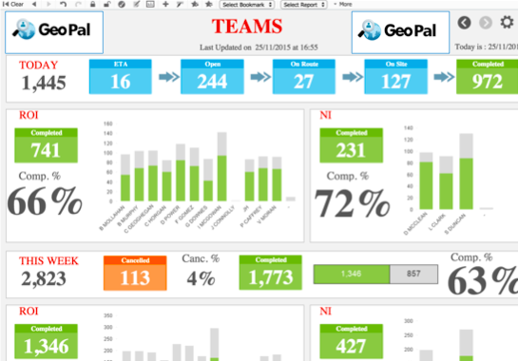
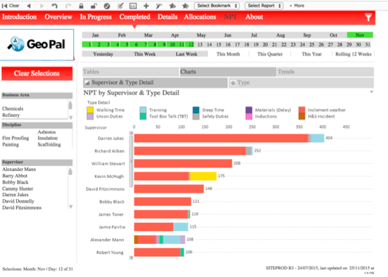
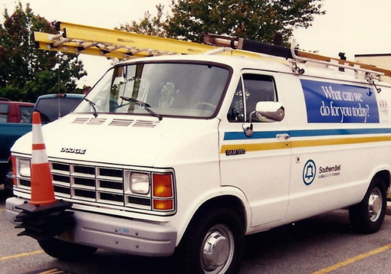

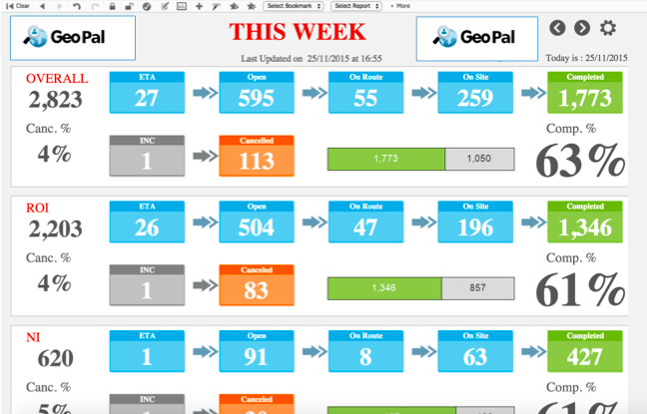
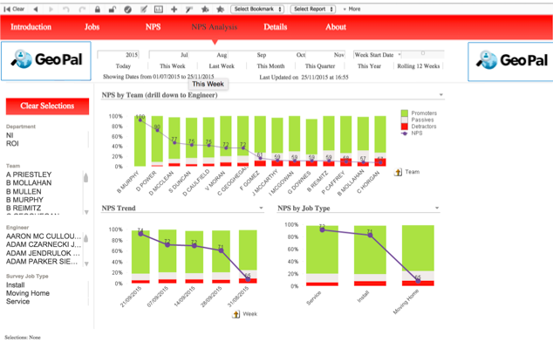


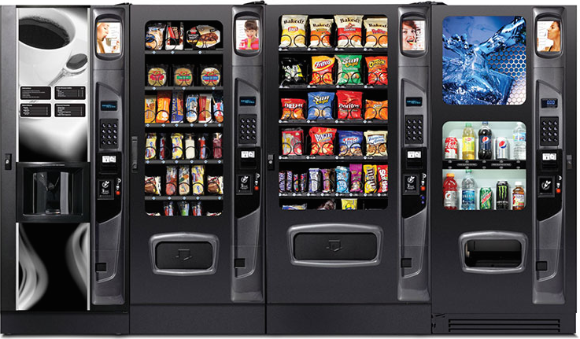



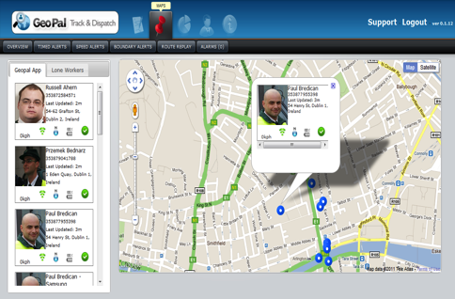
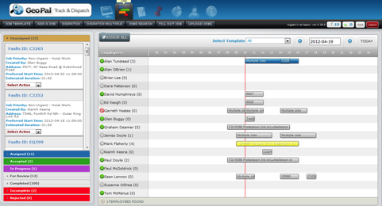



GeoPal Smart Field Service Platform
GeoPal Dashboard Module
GeoPal Web Module
GeoPal Mobile App Module
GeoPal IoT /M2M Module
GeoPal API Connect Module

Slide 12
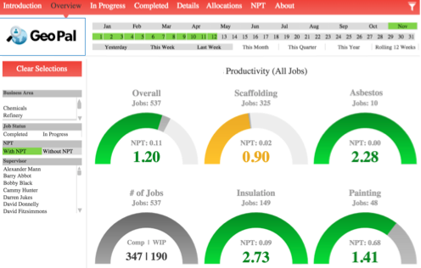
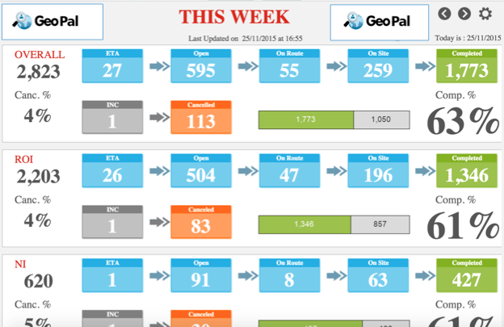
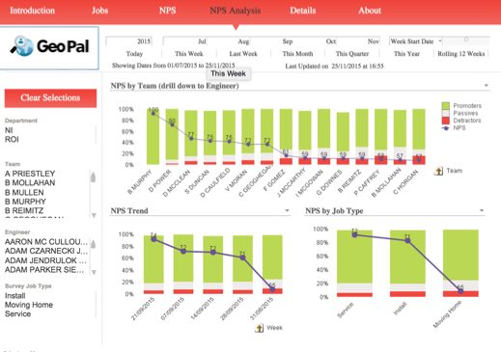
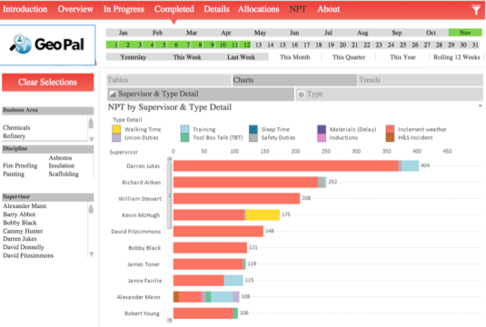
Executive Dashboard – Business Intelligence

Slide 13
Value Proposition

Slide 14



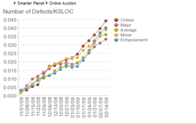

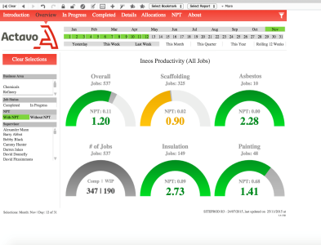
Value Proposition of Proactive IoT /M2M and MWM
Productivity
Efficiency
Asset Availability
Capture All Alarms
Intelligent
Reporting
Proof of Work Done
Operational savings of 30% through increased efficiency in deployments and decreasing false alarms.
Reduce Admin costs by 50% by eliminating paperwork
100% on-line asset status. Increase asset availability by 19% with proactive field service.
Improve reporting, and decision-making with 100% of alarms captured and access to all historical information.
Comprehensive reporting with customizable reports delivers greater transparency on KPIs and SLAs
Reduced risk by speeding up response times and mitigate risks. 100% proof of all work done and compliance

Slide 15
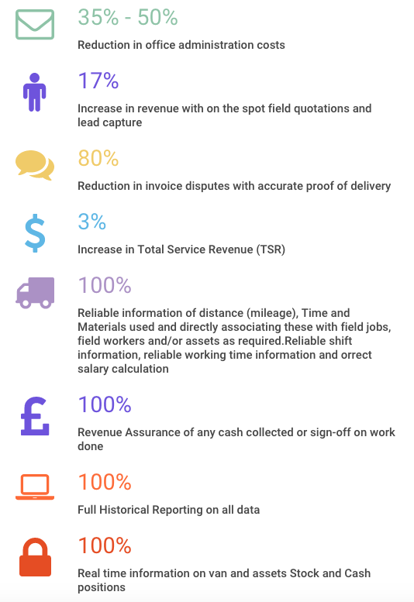
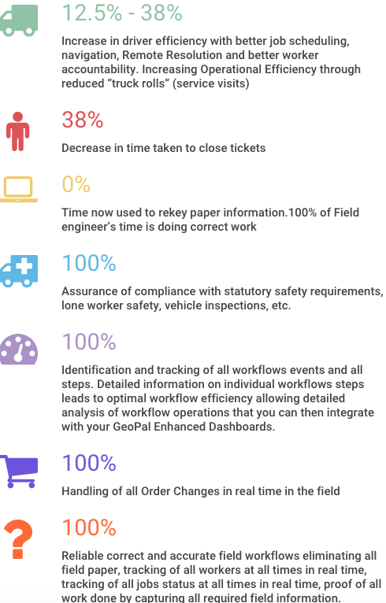
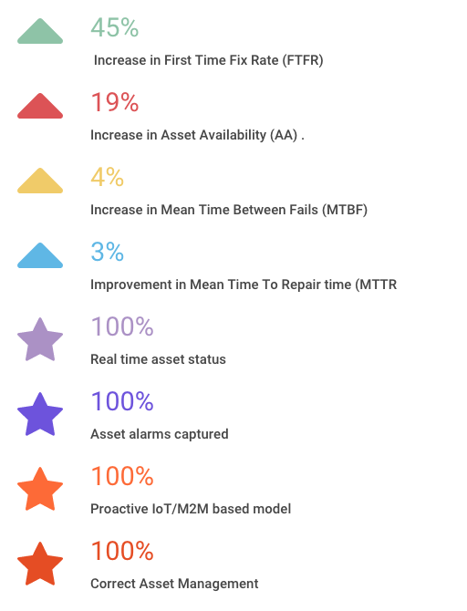
Value Proposition
Financial Benefits
Field Worker Benefits
Field Asset Benefits

Slide 16
Differentiators

Slide 17
Differentiators
Agile Platform - Maximum flexible, cost-effective solutions
100% Customised field workflows with a drag and drop GUI
100% configurable dashboards and analytics
Simple yet powerful interface allows full IoT/M2M programming.
Only solution with end to end IoT / M2M Capability: Collect Alarms; Inputs from 3rd party systems; Selecting worker; Assigning work and Completing work on mobile device
Easy integration with all types of enterprise systems with open web services APIs – “Connected Field Service”
Out of the box or integrated
Mobile focused – born from Mobile

Slide 18
Main GeoPal Features
1.0 Staff Efficiency Information/Analysis
2.0 Custom (Paperless) Job Workflows
  2.1 Remove paper
  2.2 Time and Materials Capture
  2.3 ePOD
  2.4 Proof of Attendance
  2.5 Capture order changes
  2.6 Document Scanner
  2.7 Safety and Health
  2.8 Vehicle Inspection Checks
3. Field Asset Management
4. Worker location tracking
5. Step by Step Navigation
6. Job Scheduling and Dispatch
7. On line real time Reports
8. Customer Portal
9. Data Exchange to 3rd party s/w
10. Proactive Field Service (IoT/M2M)
11. Lone Worker Protection
12. CRM
13. Credit Card Processing in the field
14. TomTom Integration

Slide 19
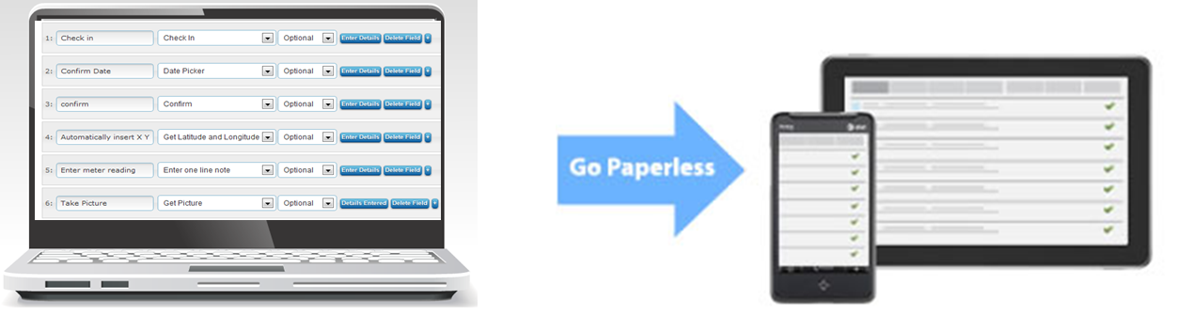
2.0 Custom Job Workflows
GeoPal has a powerful form creation studio.
Simple drag and drop interface, no programming required.
Specify which forms can be accessed by each field worker.
Multiple step types.
Conditional logic : skip to, if/then.
Form fields can include :
Photographs
Signatures
Pick lists
Comment fields
Scan bar codes
Scan RFID tags
Annotate images
Scan documents
GPS coordinates
Sketches
Videos
Parts lists
Payments collected
Voice notes

Slide 20
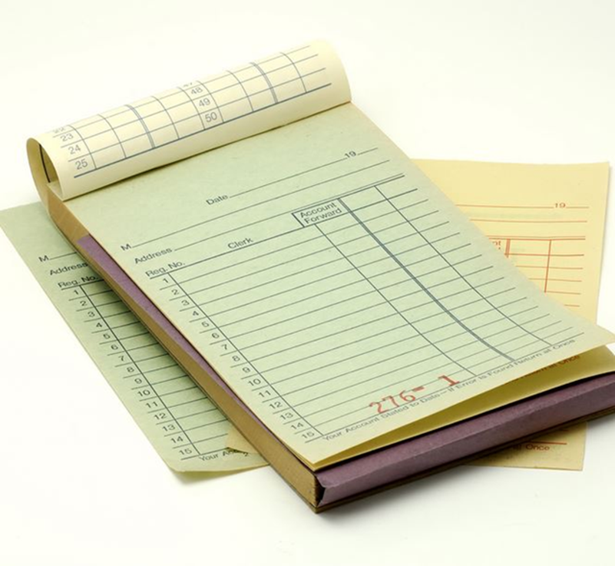
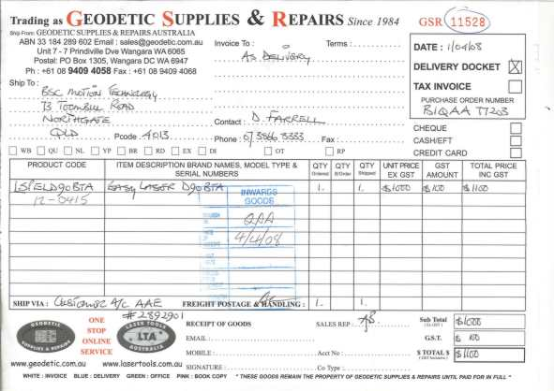
2.1 Removing Paper
Can’t get rid of all paper dockets, manifests, etc. but ……
Paperwork goes missing, never makes it back to the office.
No customer signature on the paperwork when it does arrive back.
No early warning of paper work issues until it’s too late

Slide 21

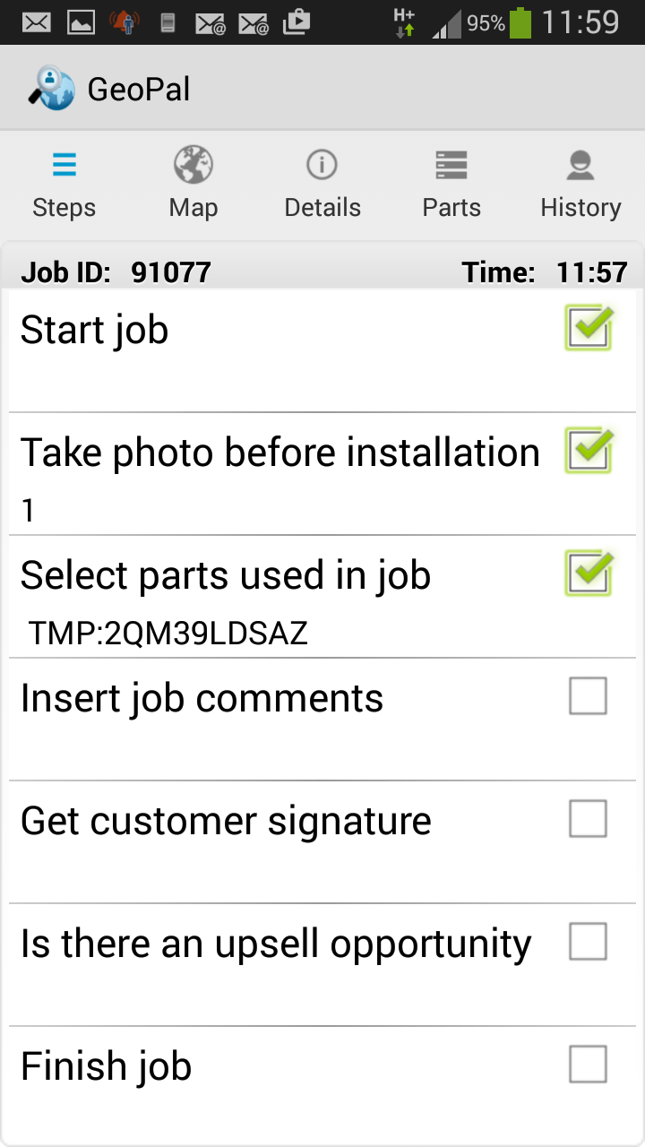

2.2 Time and Materials Capture
Replace paper job reports with mobile forms.
On the mobile app the Worker clicks “start job” and “end job” to record time spent on job.
On the mobile app the worker selects the parts & materials used on the job.
Customer can add signature to confirm agreement.
X

Slide 22
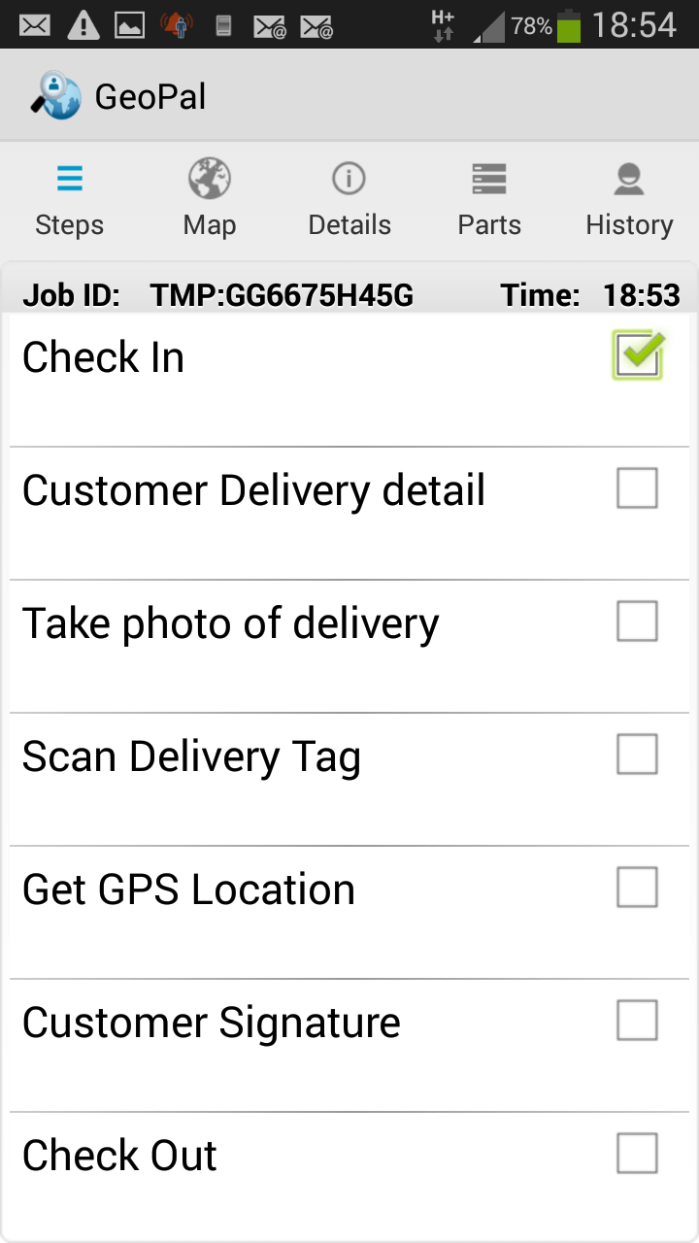

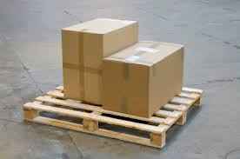
2.3 Electronic Proof of Delivery
Proof that the delivery / collection has completed by :
  Capturing customer signature ( sign on glass).
  Photo of delivered items.
  Capture GPS coordinates of collection / drop off point.
  Scan the signed delivery docket.
X
Customer Signature

Slide 23
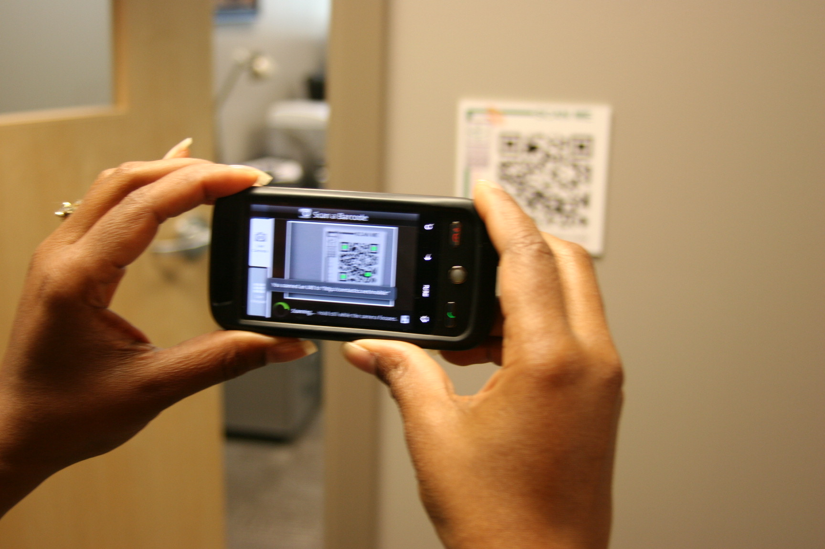
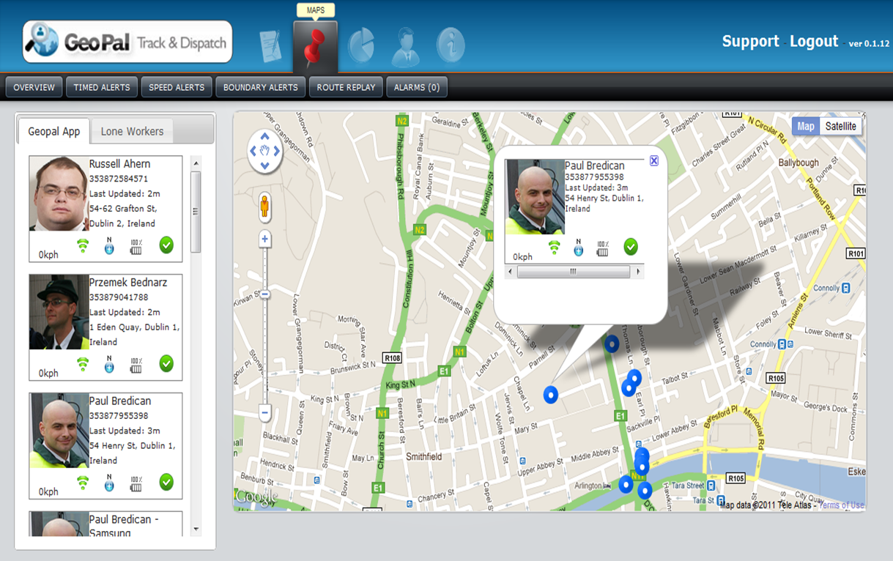
2.4 Proof of Attendance
Field worker uses the GeoPal mobile app to scan a QR code or RFID tag at the job location.
The GeoPal mobile app time stamps and geo-tags when the QR code is scanned.
The mobile app sends the GPS location of the worker back to the web site every 5 minutes.
Worker also scans the tag when job / shift finishes.

Slide 24
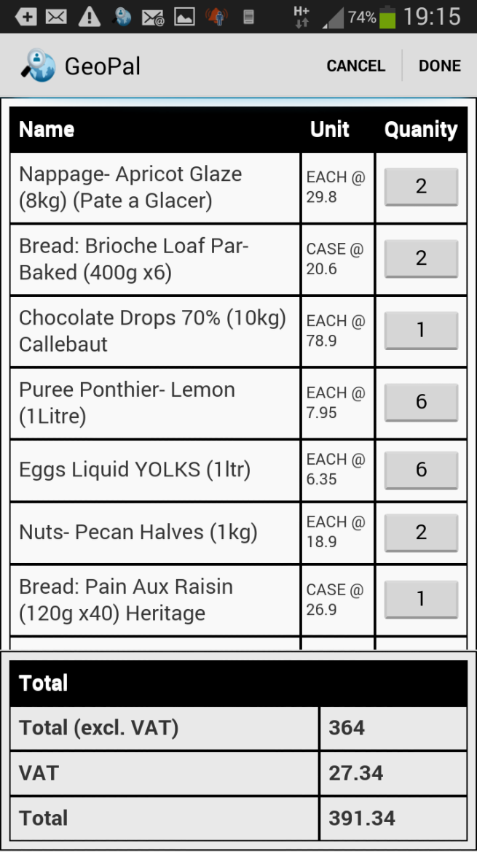
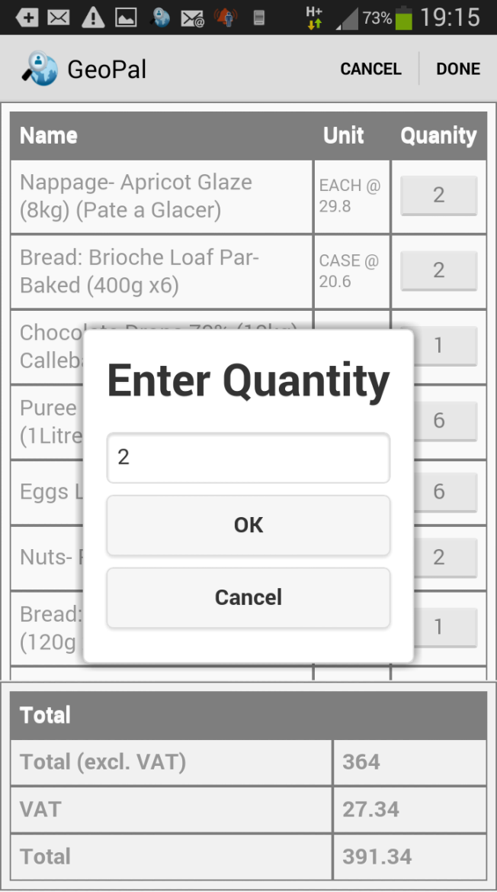
2.5 Capture Order Changes
The mobile app can display the expected items to be delivered.
The quantities can be changed on the app to show the actual items delivered.
The revised delivery details are sent back to the office immediately.
Back office Order Management systems are updated with the revised delivery details.

Slide 25
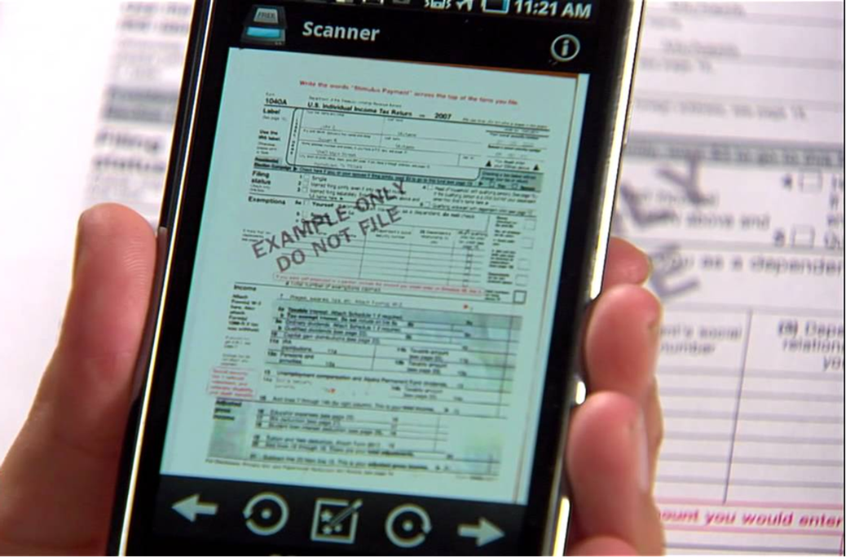
2.6 Document Scanner
The GeoPal mobile app has a feature to scan documents such as : consignment notes, delivery dockets, etc.
The scanned document is sent back to the office in real-time.
Allows customer invoices to be sent quicker.
Scanned document stored on the “cloud”.

Slide 26
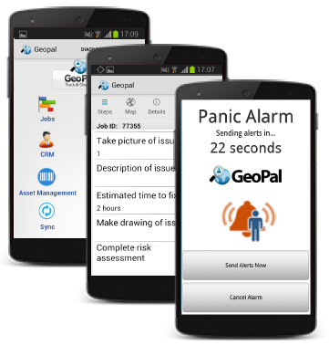
2.7 Health & Safety Compliance
Fill out Risk Assessments on the mobile app
Complete vehicle inspection checks on the mobile app
Video collaboration between the office and the field worker
Lone Worker features : Panic alarm, non-movement detection.

Slide 27
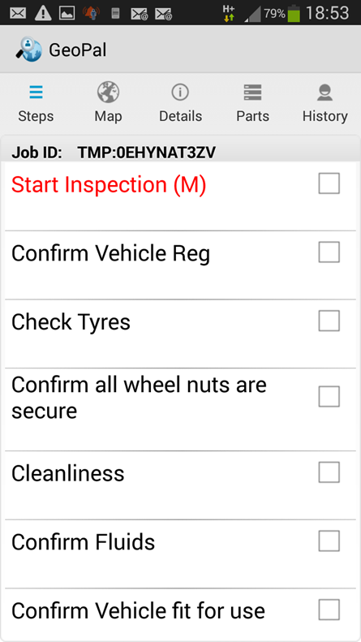
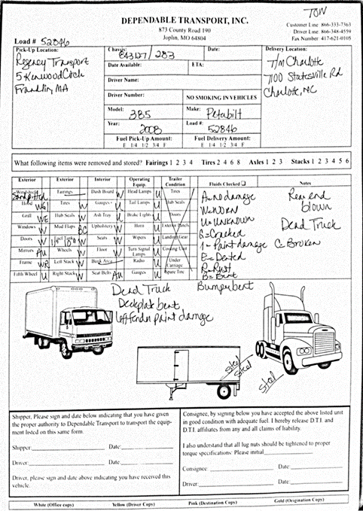
2.8 Vehicle Inspection Checks
Legislation mandates vehicle “walk-around” inspections.
A record must be kept of inspections and defects must be rectified in a timely manner.
GeoPal Vehicle Inspection mobile form eliminates paper forms, provides evidence of compliance and results are stored on the cloud indefinitely.
Major defects can trigger an email to a manager or garage.

Slide 28

4.0 Worker Location Tracking
View the real-time location of workers ( not the vehicle )
See the jobs they are working on and the status of each job
Assigned jobs to the worker closest to the job location
See if the worker is logged in to the mobile app.

Slide 29
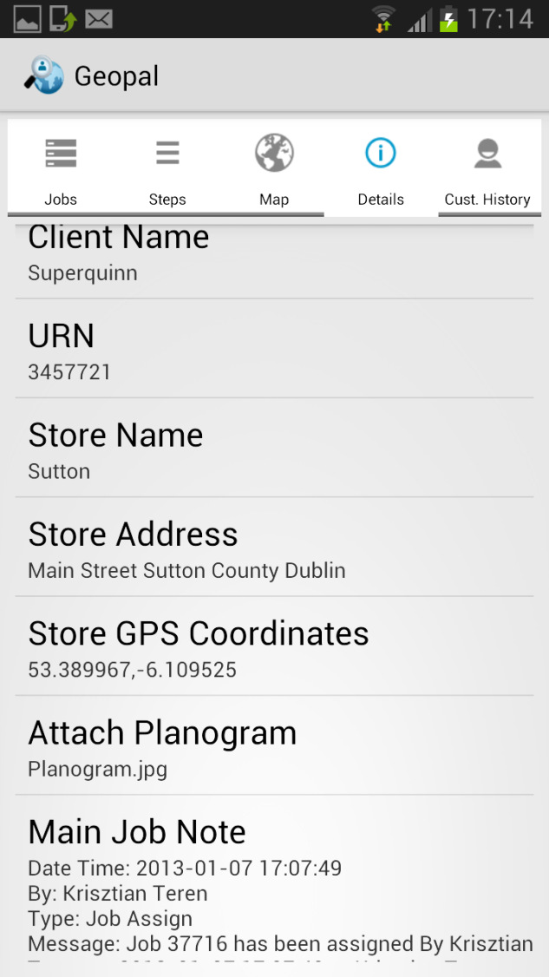
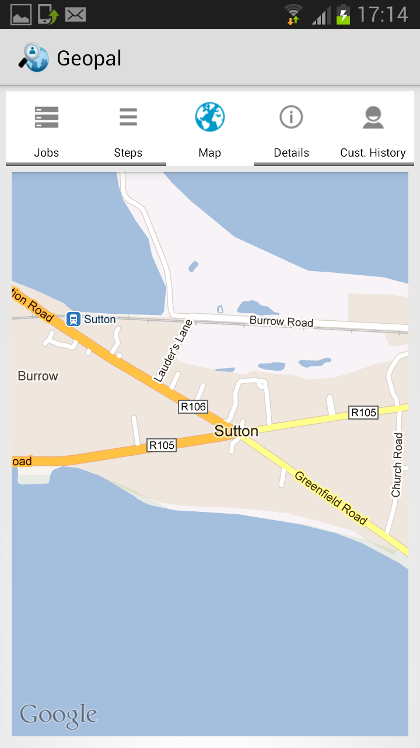

5.0 Step by Step Navigation
GPS and Address
Audio support
Live traffic conditions
Where to turn and which lane
More efficient routes.
If you get off track, Maps will automatically find a new route for you.
Estimated arrival time
The driver clicks on the GPS Coordinates or address to view the job Location and get turn by turn directions
1
2

Slide 30
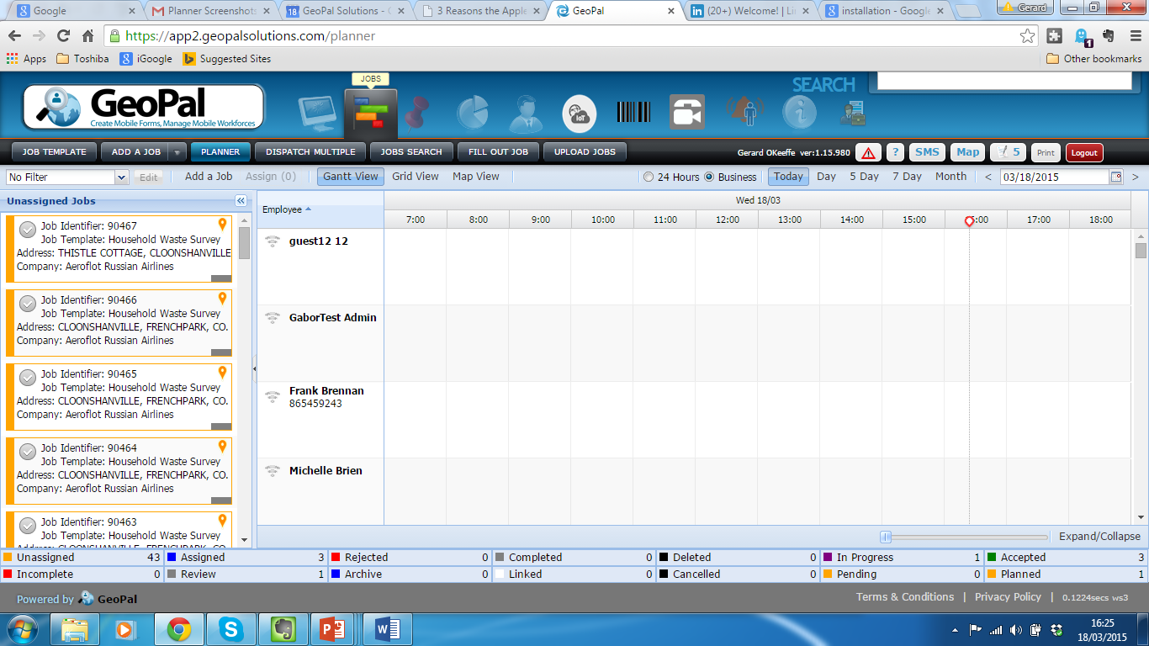
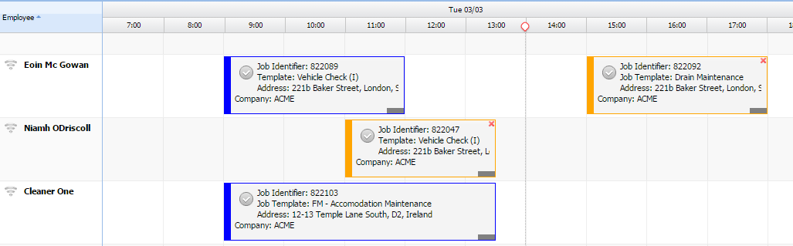

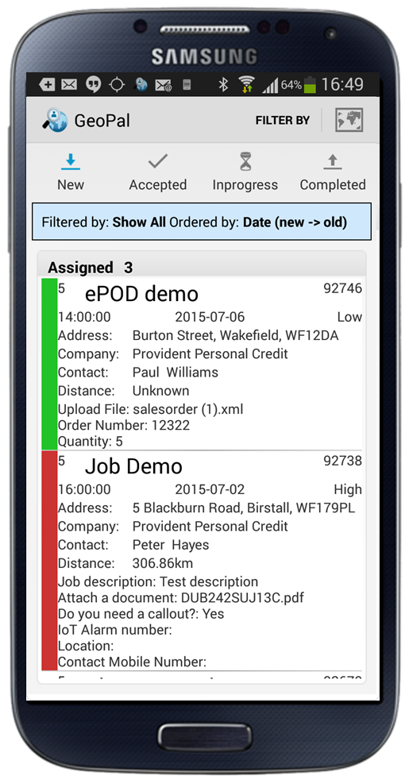
6.0 Job Scheduling and Dispatch
Simple drag and drop assignment of jobs
Different views available – planner, list, map view
Colours indicate different jobs statuses – accepted, in progress, completed, etc.
Worker receives all job details and workflow steps to be completed.
View, accept, and update job status directly

Slide 31
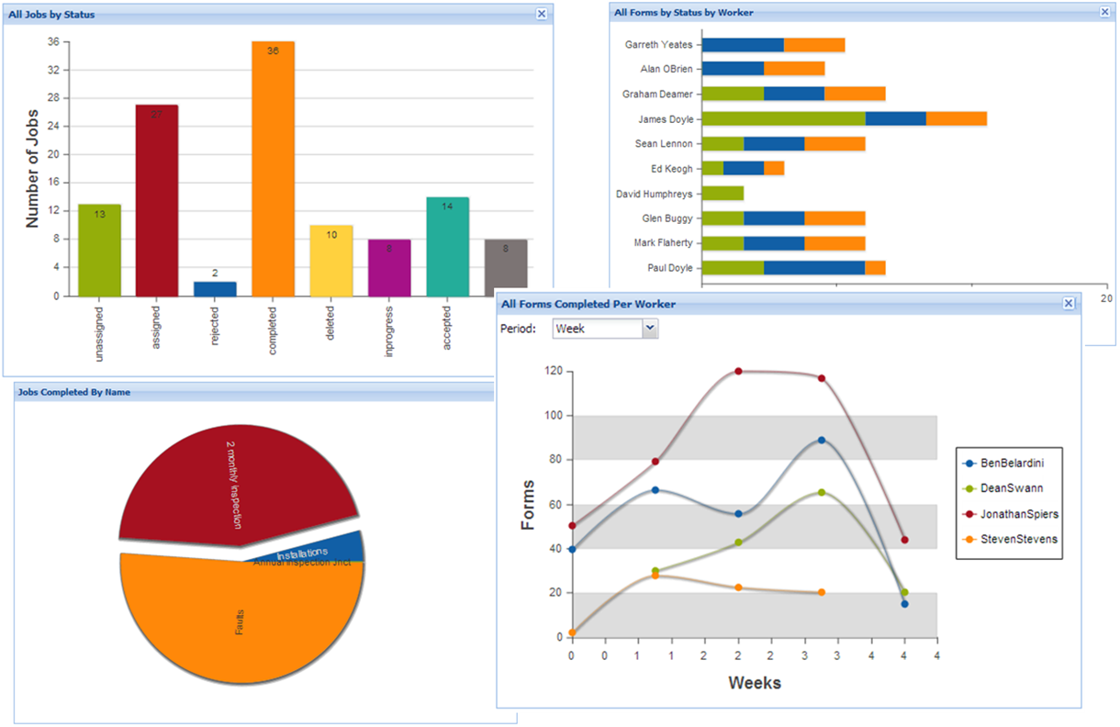
7.0 Custom Reports
Run standard reports
Create custom reports
Create pivot tables for analysis
Create heat maps and pin maps
Toggle between tabular and map views
Schedule delivery of reports via email – daily, weekly, monthly
Output in PDF, Excel, KML, XML, JSON formats.

Slide 32
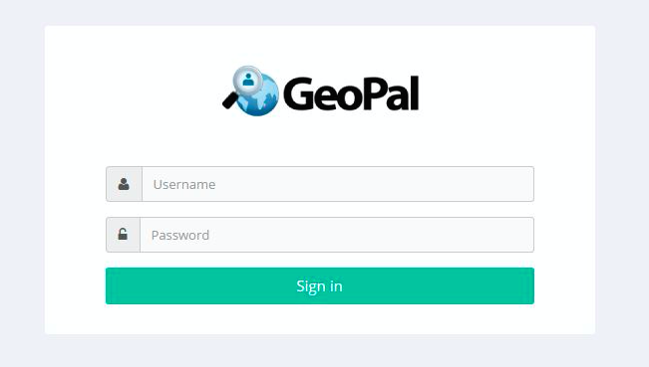
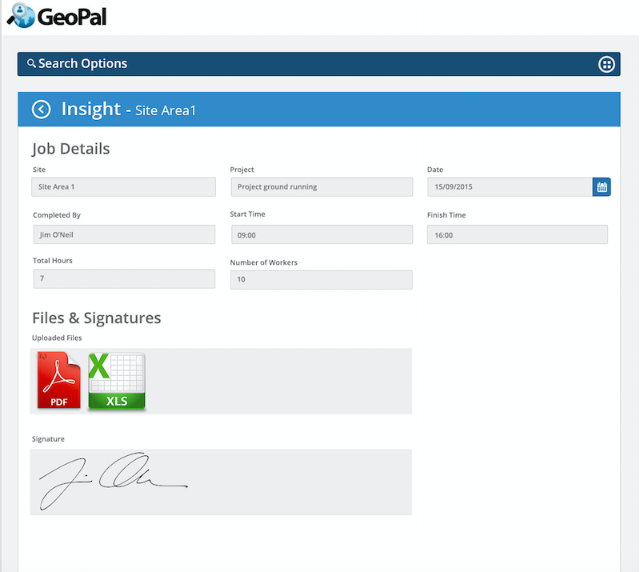
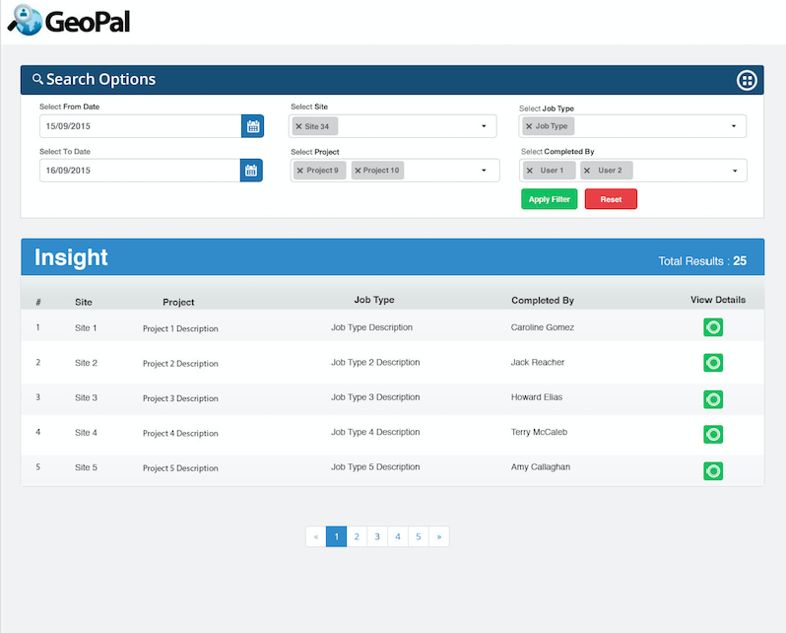
8.0 Customer Portal
Allow your customers to:
  Log in and see and report on work you are doing for them.
  Send requests for work to be done.
  Send comments on work done.
Customisable with customers Logo and colour scheme

Slide 33


9.0 Integration with Third Party Software
Integrate GeoPal with :
Finance systems : Sage, Quickpay, Freshbooks, Xero, etc
CRM : Microsoft Dynamics CRM Salesforce, SugarCRM, Zoho, etc
ERP : SAP Business 1, Microsoft Dynamics Nav, NetSuite, Sage, etc.

Slide 34
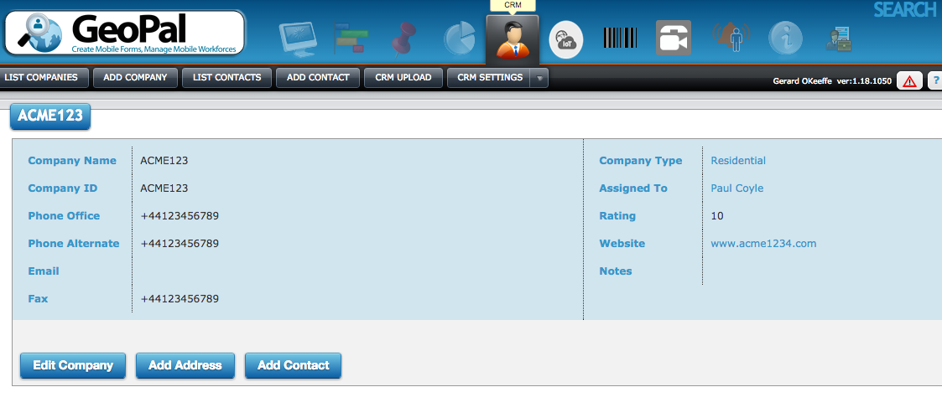
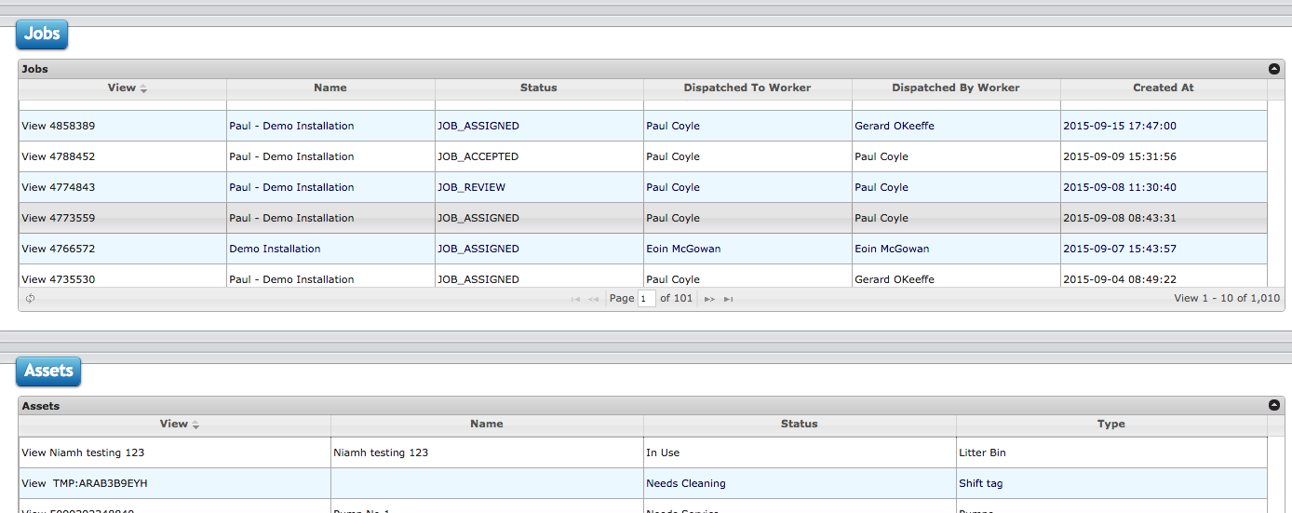
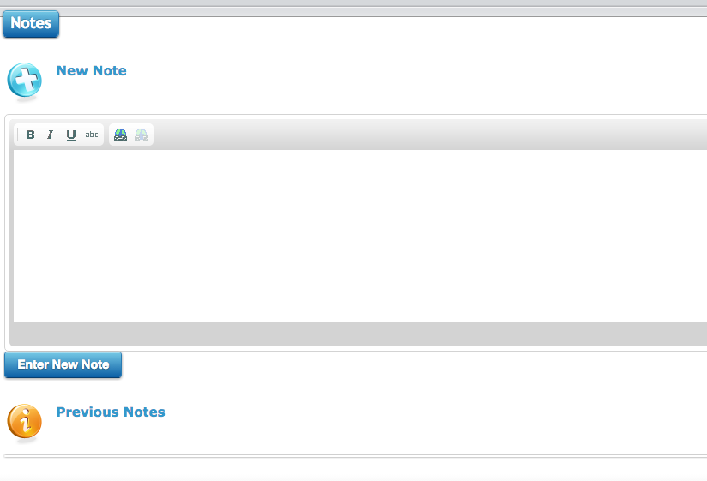
11 CRM
Log all contact details
See in one place all jobs undertaken for all locations over any period of time
Store any asset information for all locations
Add Extra field and notes as you require for example to categorise and classify your clients

Slide 35
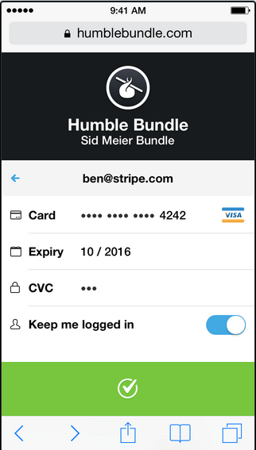

12 Credit Card Payment
Accept and Process credit card payments in the field
Accept signatures with card
Use your own logo and colours

Slide 36

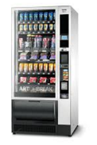
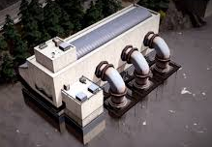

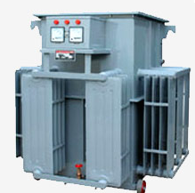
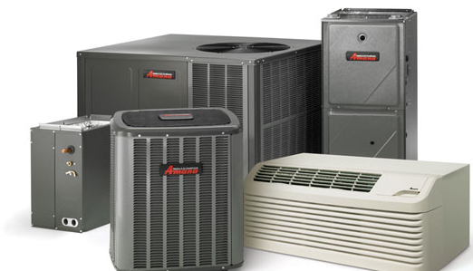






GeoPal Intelligent Job Dispatch with Full Dash boards
Sensors on Equipment
and Buildings
Full Dash Boards
GeoPal Collect Alarms
Operator
Network
2
1
5
4
3
Job Completion Data Captured on Mobile app
Work Orders automatically assigned to field Staff

Slide 37

IoT / M2M - Field Asset Management
Register all field assets
Set up service and maintenance schedules
Visualisation of Asset Status on GeoPal.
Asset Status updated by IoT/M2M sensors in the field.
Asset Jobs dispatched based on Rules entered in Rules Table

Slide 38






IoT / M2M Sensor Data Interface
Visualisation of Asset Status on GeoPal.
Asset Status updated by IoT sensors in the field.
Asset Jobs dispatched based on Rules entered in Rules Table.
Can cater for thousands of alarms per hour
IoT Sensors
GeoPal
IoT Alarms
Rules
Table
Mobile
Data Network
Or Other

Slide 39


Example Water Pumping Buildings
Sample of Dash Board Vending Metrics to be Monitored
Customised Reports providing KPIs (all from machine controller)
All Contractors
Electrical and Mechanical Metrics
  Energy usage and temperature
  Security and Tampering Alarms
  Power-offs
  Faults due to vandalism and theft
Financial Metrics
  Asset Availability
  Building maintenance / security costs

Slide 40
Demo

Slide 41
Demo
IoT/M2M Un-manned pump stations (21 Steps)
Water meter installation and Anti-fraud systems (Meter Fraud Check – 62 Steps )
Vehicle Inspection Report (Vehicle Check – 16 steps)

Slide 42
Appendix

Slide 43









GeoPal Methodology
Agree the Key Performance Indicators
Capture Field Operations data
Report on KPIs each month
Configure GeoPal mobility platform
Train office staff and field staff on use of GeoPal
Measure current KPIs (Baseline)
Implement Improvements
GeoPal expert access Programme
Data → Information → Analysis → Action

Slide 44







IoT / M2M Sensor and Equipment Partners

Slide 45
TomTom - GeoPal Specific Features

Slide 46



Integrated GeoPal and
TomTom Telematics Solution
Assign job to driver with shortest travel time to job ( as determined by TomTom Telematics )
Send a text message or email to Customer with Estimated Time of Arrival
Dispatch job to GeoPal mobile app and TomTom Sat Nav at the same time
Use GeoPal mobile app to capture job details : time, parts, signatures, photos, etc.
Driver Accepts Job on the Sat Nav and navigates to job location
Capture mileage driven and include it in the job report.

Slide 47
Electronic Proof of Delivery ( ePOD )

Slide 48





Capture Parts Used In Jobs

Slide 49



Offline Working
Receive Jobs while on-line
Complete Jobs while off-line
Job data syncs automatically when connection re-established

Slide 50
Lone Worker Safety

Slide 51






Integrated Solution
Assign Job
Accept Job
Send ETA to
Customer
Capture Job
Details
Send Invoice

Slide 52

GeoPal Platform
IoT Sensor Data Interface
Location & Inventory
Intelligent Job Dispatch
Mobile Data Capture

Slide 53
GeoPal Platform
IoT Sensor Data Interface
Location & Inventory
Intelligent Job Dispatch
Mobile Data Capture
GeoPal takes Field Service Management to the next level

Slide 54








GeoPal Models
Software
as a Service
Platform
as a Service
Field Service & Facilities Management
Public Services
Systems Integrators
SharePoint Partners
Home Health Care
Civil Engineering & Surveying
IT Solutions Providers
Business Consultancies

Slide 55
Example 1 : Enterprise Solution 1K + New Lines
Bourne Leisure – NEW LINES
  Challenge: Tracking staff in the field
  Equipment: 4.5 inch Smartphones, 2Gig Data, covers and insurnace
  Solution: GeoPal Location and Mapping
  Benefits: 50% reduction in administration costs and 30% more field worker productivity
1. Location & Mapping

Slide 56

Example 2: Large Solution 500 + New Lines
Home Alone - NEW LINES
  Challenge: High admin costs and paying for timenot worked
  Equipment: 5 inch Smartphones, 3Gig Data and covers
  Solution: GeoPal Job Scheduling and Dispatch
  Benefits: 20% increase in worker productivity and 100% proof of delivery for regulatory compliance and time and attendance
2. Job Scheduling & Dispatch

Slide 57



Example 3 : SMB Solution 100 + New Lines
Go Eagle One - NEW LINES
  Challenge: Follow specified workflows
  Equipment: 7 inch Tablets , 3Gig Data, covers and insurnace
  Solution: Capture field info on mobile device.
  Benefits: 100% proof of compliance and real time (same day) billing
3. Mobile Data Capture

Slide 58






Example 4: Solution 50 + New Lines
Traffic Solutions – Upsell lines to Smartphones
  Challenge: Penalties from SLAs due to delays in fixing city traffic lights
  Equipment: 11 inch Tablets , 3Gig Data, covers, insurnace and MDM
  Solution: GeoPal APIs and GeoPal Job scheduling and Dispatch
  Benefits: All Assets in a single database for efficient asset management
4. Asset Management

