Slide 1
Smart Connected Cities
GeoPal Platform Overview (part Two)

Slide 2
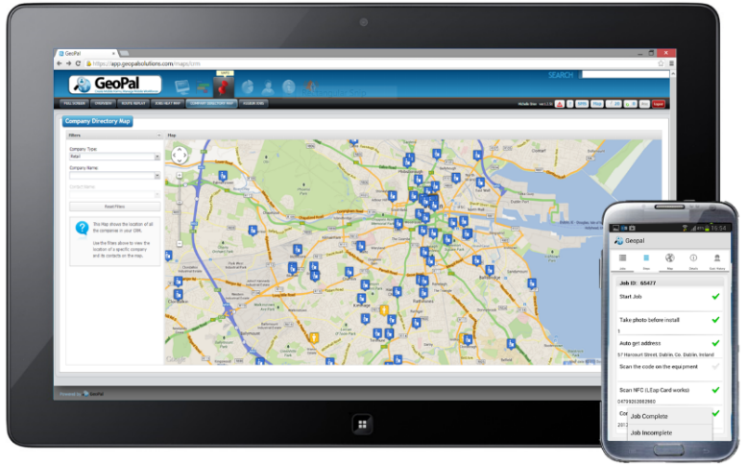

What is GeoPal?
GeoPal is a cloud service and mobile app for Public Sector bodies to cost effectively and smartly manage field operations.
Mobile data capture with photographs, time, date & location stamps
Job scheduling and dispatch with status tracking
Asset Management System with Map view functionality
Flexible IoT / M2M functionality
Seamless integration with CRM, GIS, or other IT systems
Health & Safety Legislation compliance with mobile forms for
Risk Assessment and Vehicle Roadworthiness Inspection Checks
Lone Worker Protection, panic alarm and still detection
Notes:
GeoPal’s mobile workforce management solutions
Simplify scheduling for your field-based workforce
Eliminate paperwork and reduce your admin costs
Improve visibility of employees and assets in the field
Increase accuracy of data collection and reporting
Enhance customer satisfaction with real-time proof of delivery
Help you to increase efficiency and cash flow
Provide protection for lone workers

Slide 3
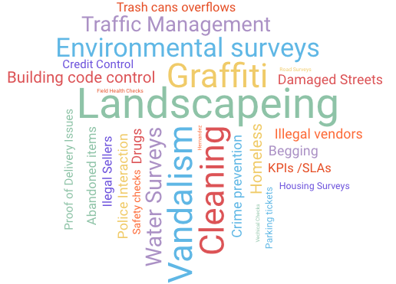
Areas Of Operation

Slide 4
Problems Solved by GeoPal
Lack of key Information to drive productivity and efficiencies
Not meeting KPIs /SLAs
Revenue Assurance problems
Proof of Delivery Issues
Excessive penalties
Mileage Time and Material capture
Excess of Paper Forms
Market differentiation to win new business
No real-time job status
Lack of Visibility of Workers
Health & Safety Issues
Regular Vehicle Inspections
Field Asset Management
Inefficient Job Scheduling
Inefficient Navigation

Slide 5

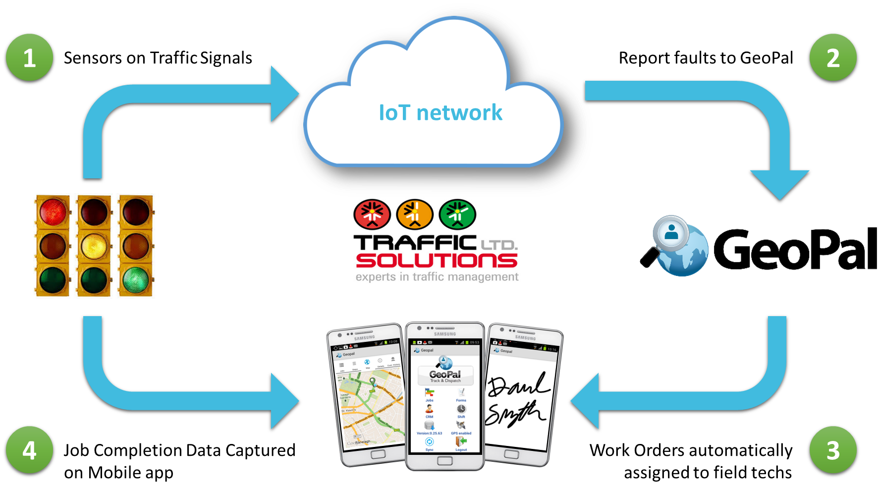
Success Story – Fingal Dublin
Dublin (Fingal) City are using GeoPal for Environmental Surveys and
Traffic Junction Fault Management

Slide 6
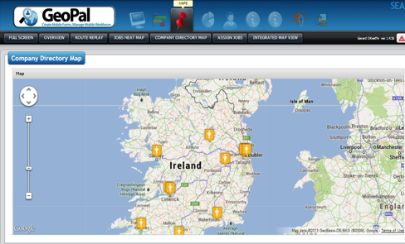
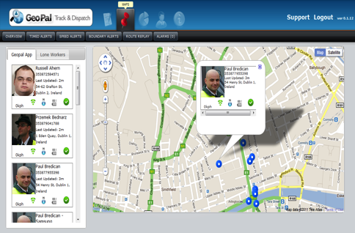


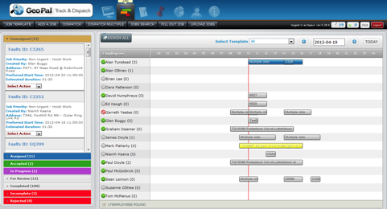
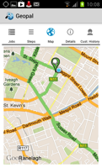
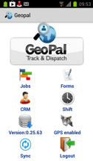
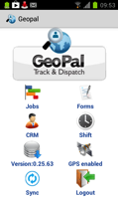

GeoPal Platform
IoT Sensor Data Interface
Location & Inventory
Intelligent Job Dispatch
Mobile Data Capture

Slide 7
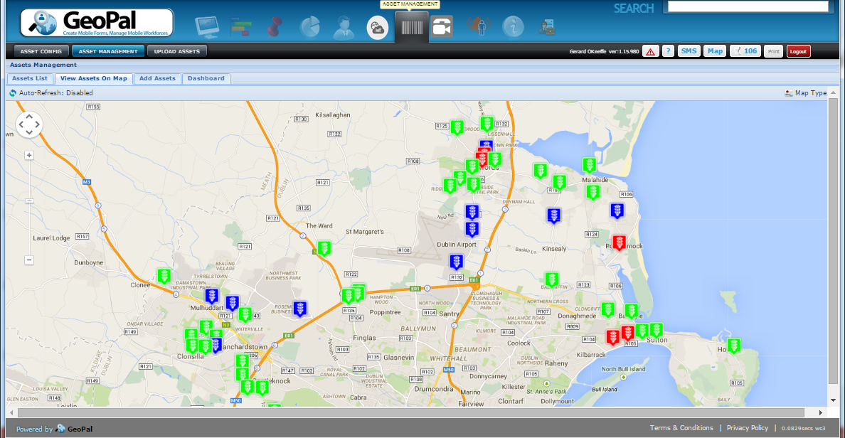
Success Story – Fingal County Council ….. continued
Map of Fingal County Council Traffic Junctions on GeoPal – showing real-time faults.

Slide 8
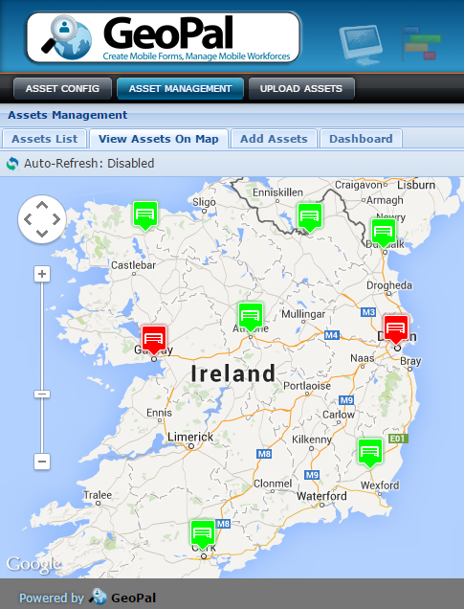

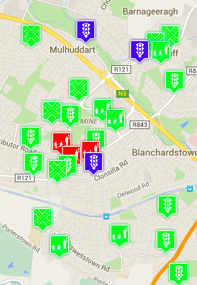



IoT / M2M Sensor Data Interface
Visualisation of Asset Status on GeoPal.
Asset Status updated by IoT sensors in the field.
Asset Jobs dispatched based on Rules entered in Rules Table.
Can cater for thousands of alarms per hour
IoT Sensors
GeoPal
IoT Alarms
Rules
Table
Mobile
Data Network
Or Other

Slide 9
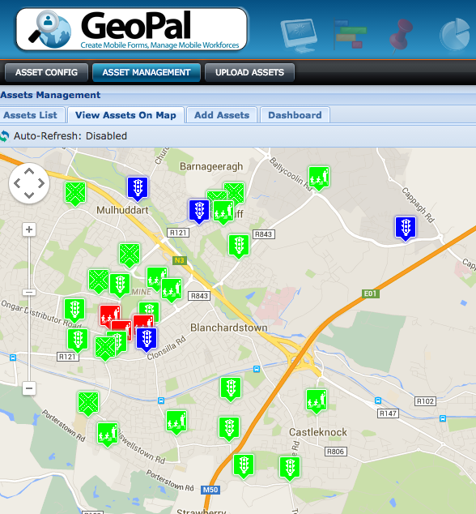
IoT / M2M - Field Asset Management
Register all field assets
Set up service and maintenance schedules
Visualisation of Asset Status on GeoPal.
Asset Status updated by IoT/M2M sensors in the field.
Asset Jobs dispatched based on Rules entered in Rules Table

Slide 10
Smart Facility Management – use cases
Wireless proof
of attendance
Fire Extinguisher
usage
Environmental sensors:
Carbon monoxide, air quality
Safety Equipment
Usage

Slide 11
Smart City – use cases
Detecting available parking
Smart street lighting
Monitoring Traffic Junction Faults
Measuring air, water quality, noise levels
Bin Level
Detection
Structural Health – cracks in buildings.

Slide 12
Appendix

Slide 13
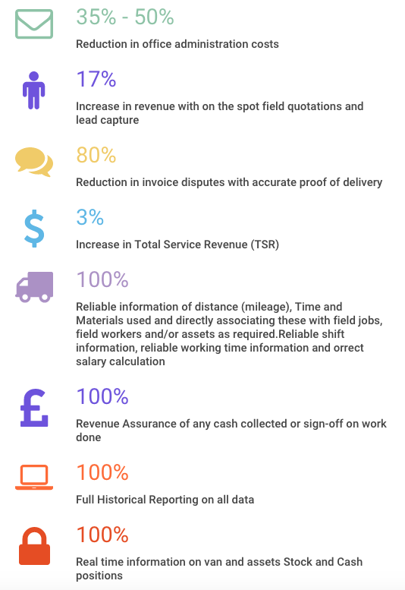
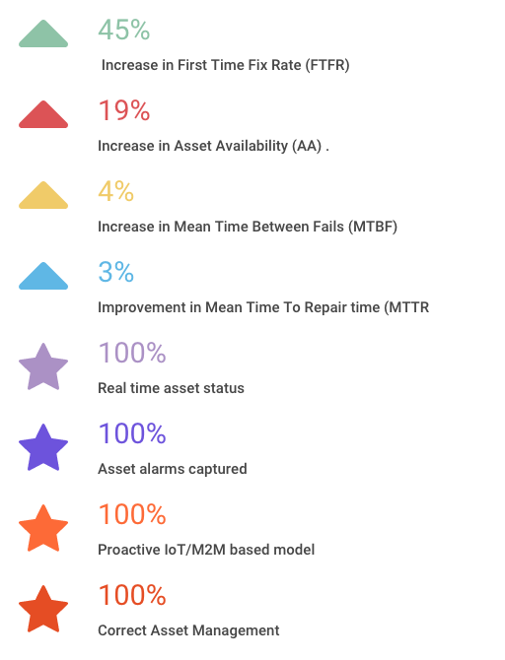
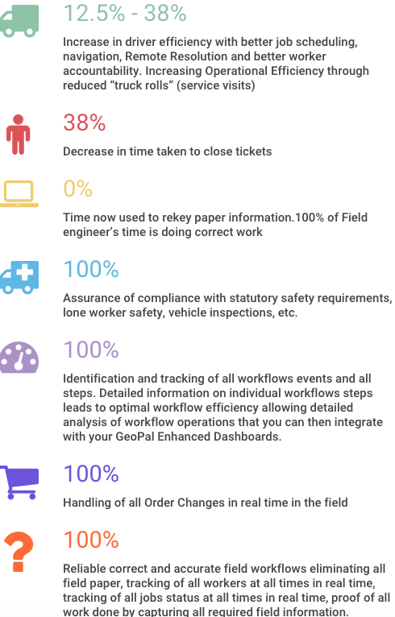
Detailed Value Proposition
Financial Benefits
Field Worker Benefits
Field Asset Benefits

Slide 14



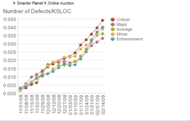

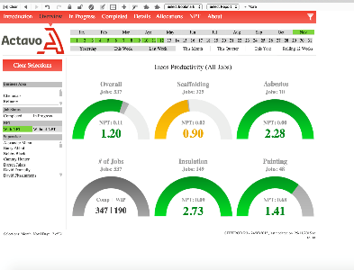
Value Proposition of Proactive IoT /M2M and MWM
Productivity
Efficiency
Asset Availability
Capture All Alarms
Intelligent
Reporting
Proof of Work Done
Operational savings of 30% through increased efficiency in scheduling and deployments
Reduce Admin costs by 50% by eliminating paperwork
100% on-line asset status. Increase asset availability by 19% with proactive field service.
Improve reporting, and decision-making with 100% of alarms captured and access to all historical information.
Comprehensive reporting with customizable reports delivers greater transparency on KPIs and SLAs
Reduced risk by speeding up response times and mitigate risks. 100% proof of all work done and compliance

Slide 15
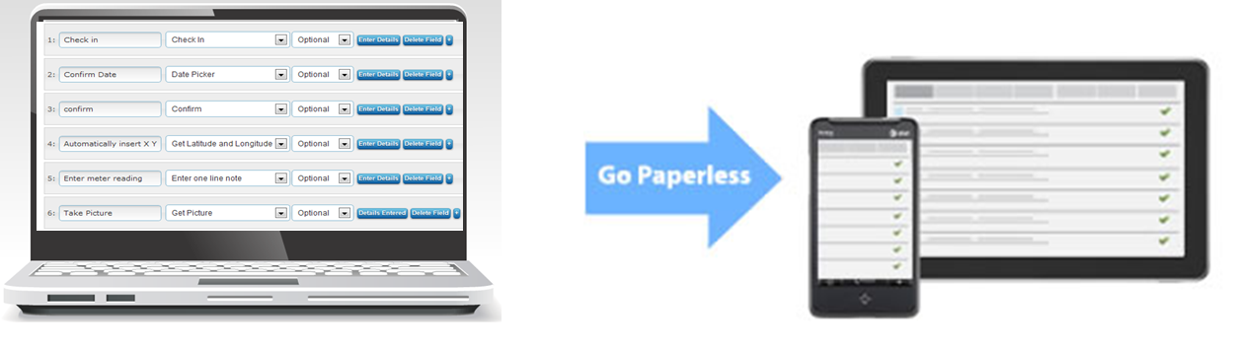
2.0 Custom Job Workflows
GeoPal has a powerful form creation studio.
Simple drag and drop interface, no programming required.
Specify which forms can be accessed by each field worker.
Multiple step types.
Conditional logic : skip to, if/then.
Form fields can include :
Photographs
Signatures
Pick lists
Comment fields
Scan bar codes
Scan RFID tags
Annotate images
Scan documents
GPS coordinates
Sketches
Videos
Parts lists
Payments collected
Voice notes

Slide 16
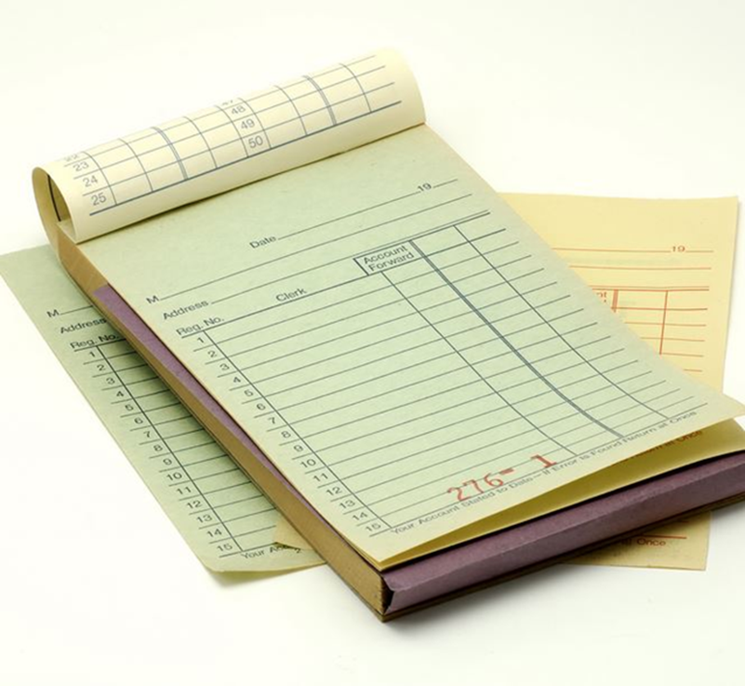
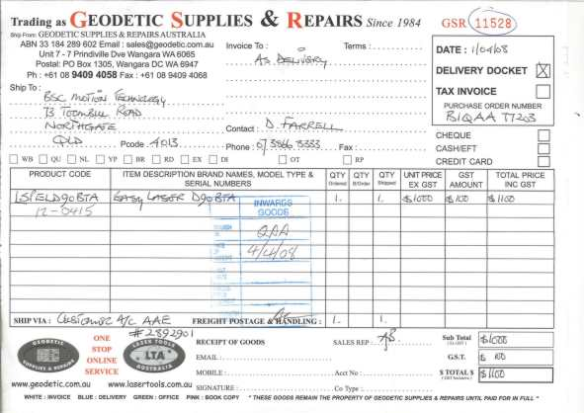
2.1 Removing Paper
Can’t get rid of all paper dockets, manifests, etc. but ……
Paperwork goes missing, never makes it back to the office.
No customer signature on the paperwork when it does arrive back.
No early warning of paper work issues until it’s too late

Slide 17

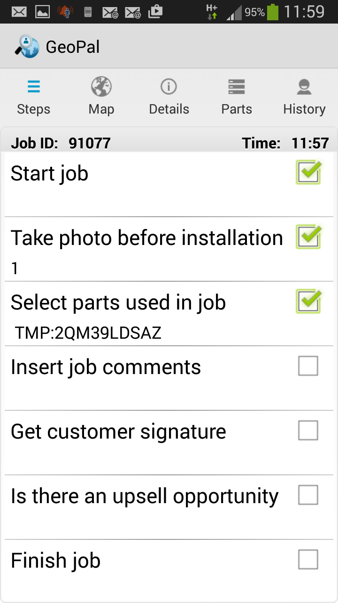

2.2 Time and Materials Capture
Replace paper job reports with mobile forms.
On the mobile app the Worker clicks “start job” and “end job” to record time spent on job.
On the mobile app the worker selects the parts & materials used on the job.
Customer can add signature to confirm agreement.
X

Slide 18
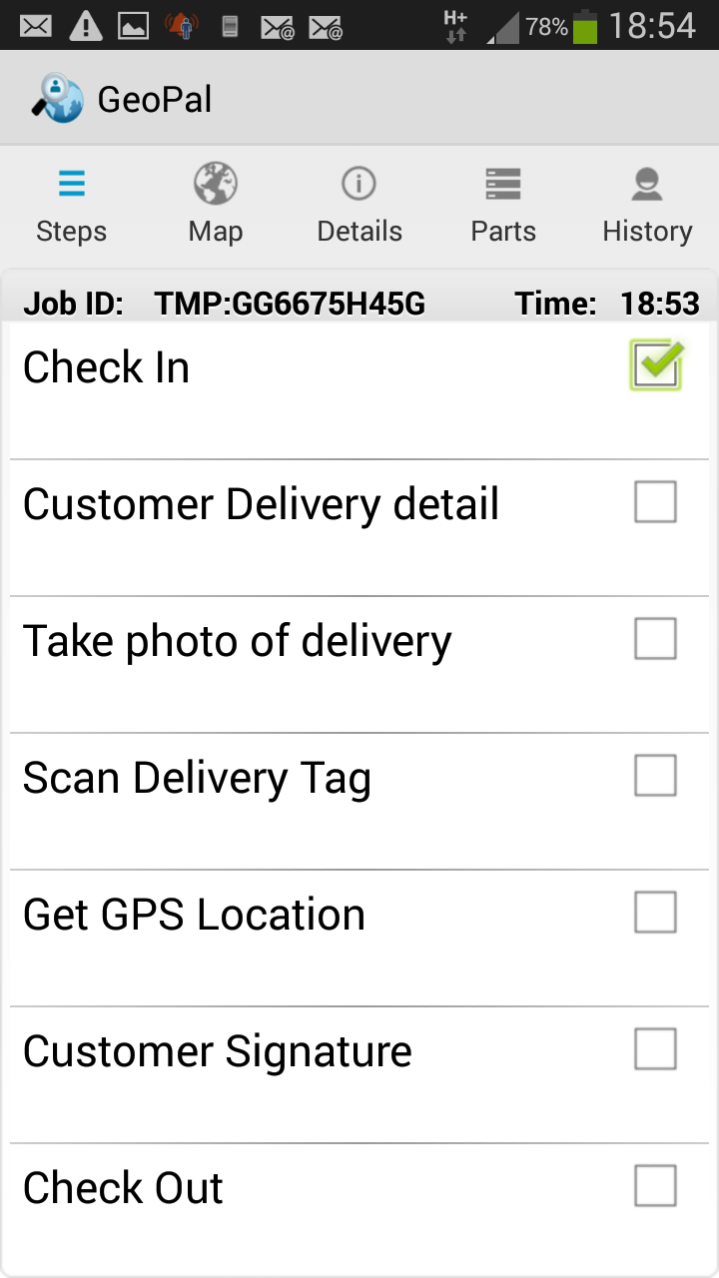

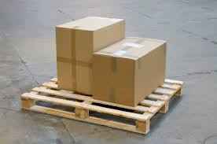
2.3 Electronic Proof of Delivery
Proof that the delivery / collection has completed by :
  Capturing customer signature ( sign on glass).
  Photo of delivered items.
  Capture GPS coordinates of collection / drop off point.
  Scan the signed delivery docket.
X
Customer Signature

Slide 19
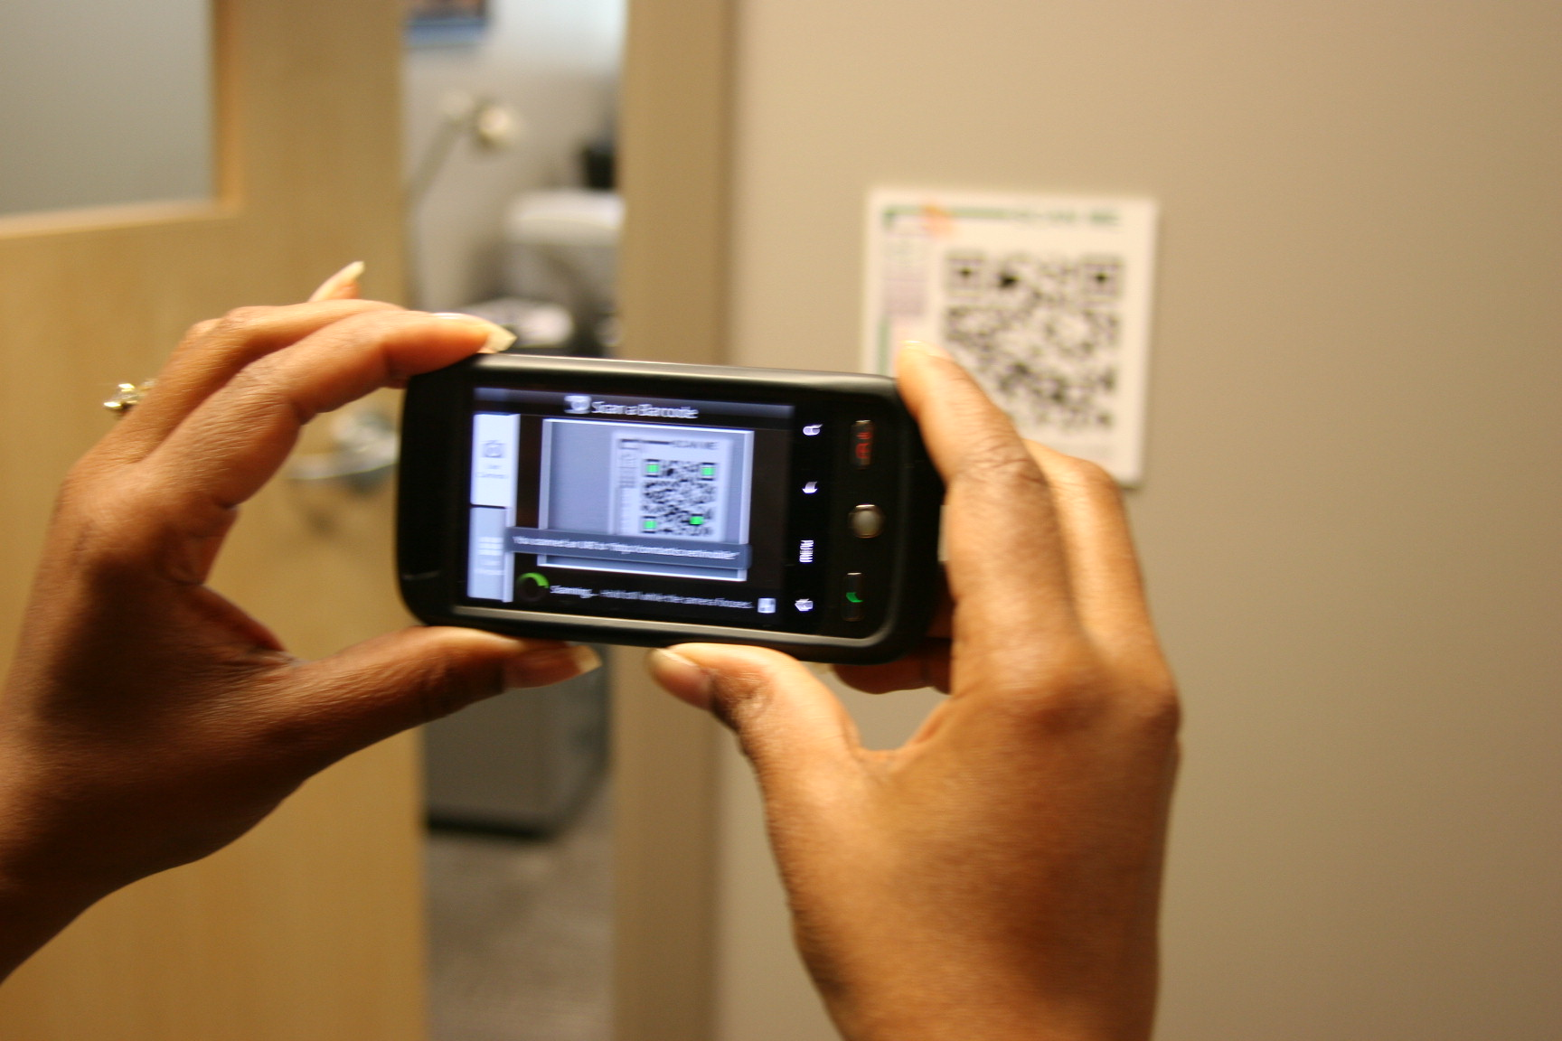
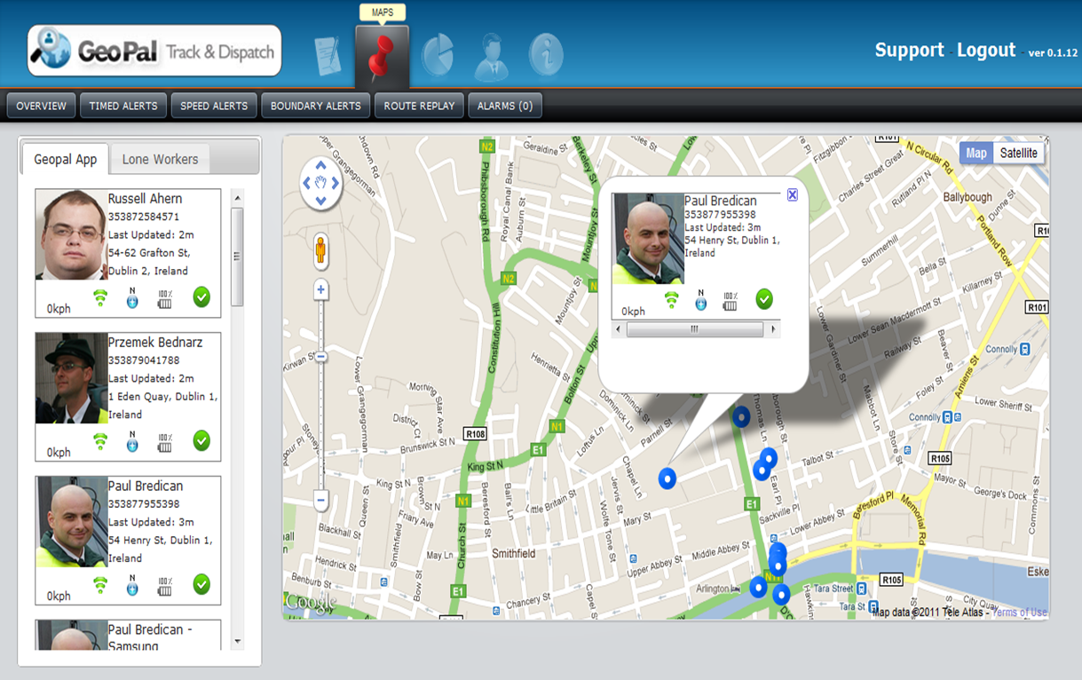
2.4 Proof of Attendance
Field worker uses the GeoPal mobile app to scan a QR code or RFID tag at the job location.
The GeoPal mobile app time stamps and geo-tags when the QR code is scanned.
The mobile app sends the GPS location of the worker back to the web site every 5 minutes.
Worker also scans the tag when job / shift finishes.

Slide 20
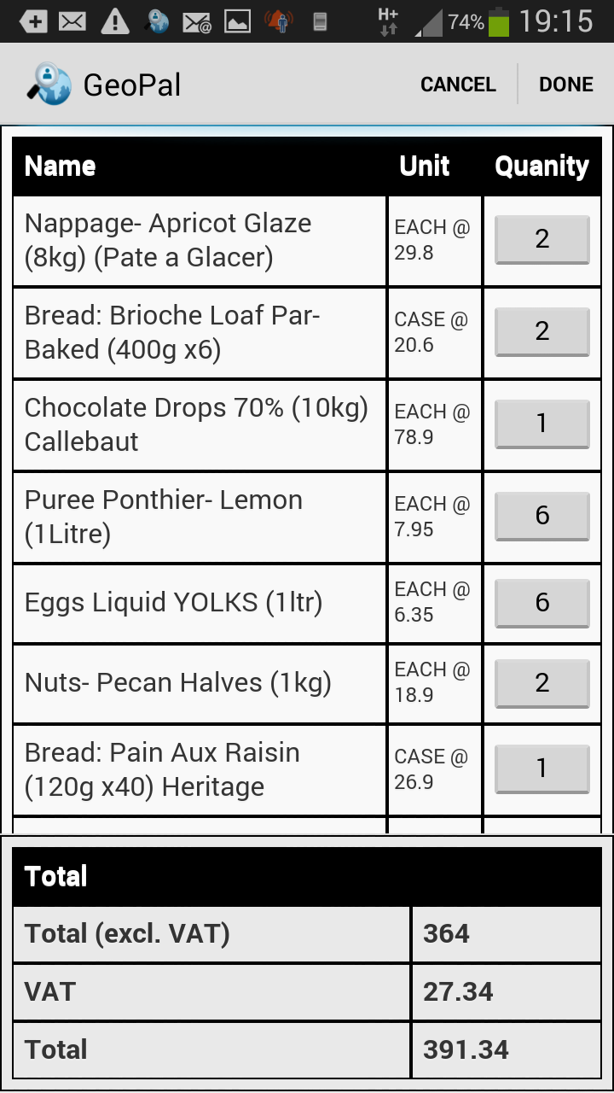
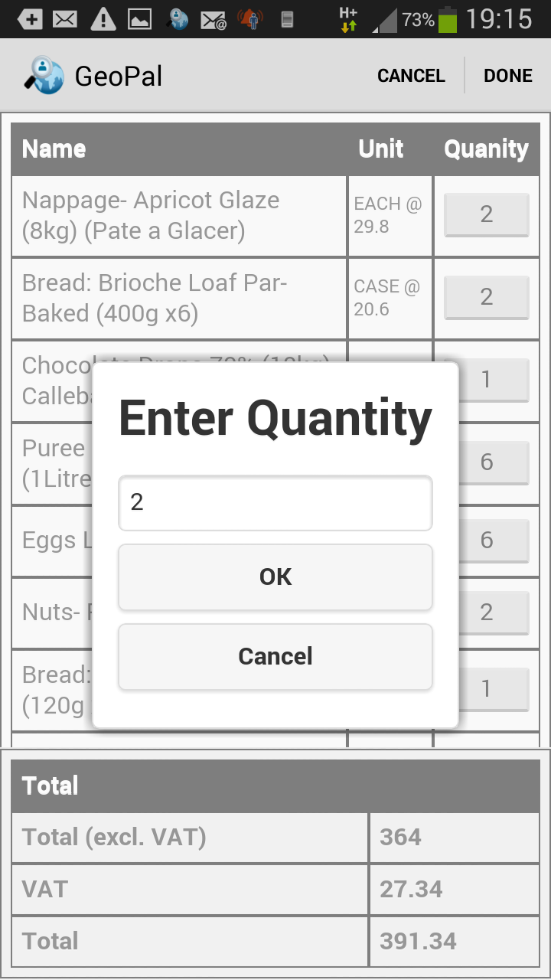
2.5 Capture Order Changes
The mobile app can display the expected items to be delivered.
The quantities can be changed on the app to show the actual items delivered.
The revised delivery details are sent back to the office immediately.
Back office Order Management systems are updated with the revised delivery details.

Slide 21
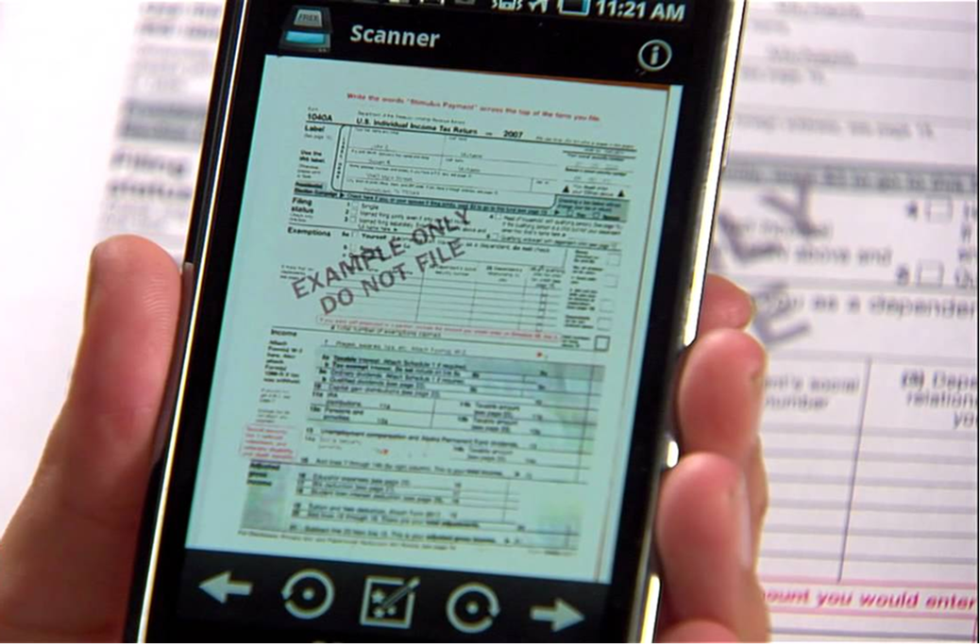
2.6 Document Scanner
The GeoPal mobile app has a feature to scan documents such as : consignment notes, delivery dockets, etc.
The scanned document is sent back to the office in real-time.
Allows customer invoices to be sent quicker.
Scanned document stored on the “cloud”.

Slide 22
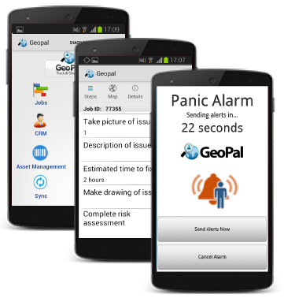
2.7 Health & Safety Compliance
Fill out Risk Assessments on the mobile app
Complete vehicle inspection checks on the mobile app
Video collaboration between the office and the field worker
Lone Worker features : Panic alarm, non-movement detection.

Slide 23
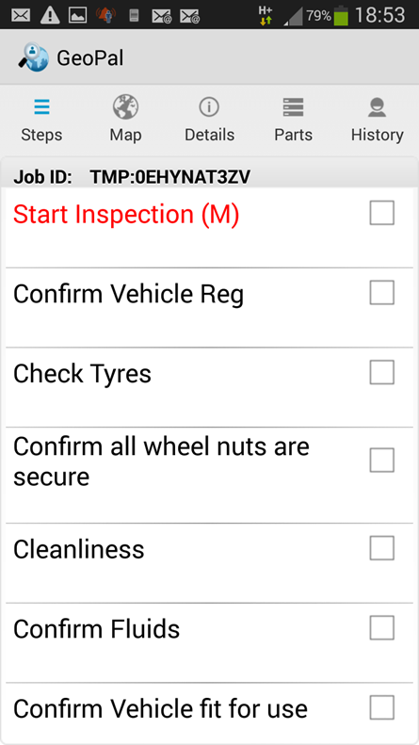
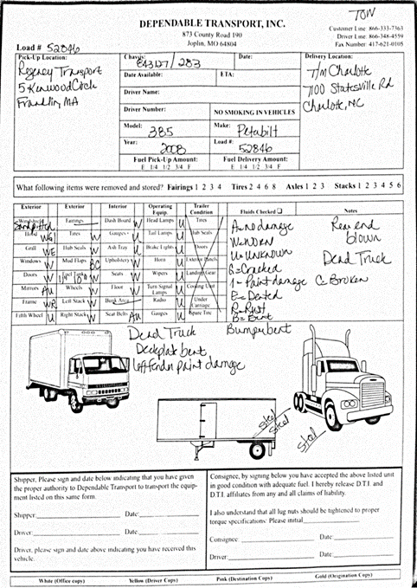
2.8 Vehicle Inspection Checks
Legislation mandates vehicle “walk-around” inspections.
A record must be kept of inspections and defects must be rectified in a timely manner.
GeoPal Vehicle Inspection mobile form eliminates paper forms, provides evidence of compliance and results are stored on the cloud indefinitely.
Major defects can trigger an email to a manager or garage.

Slide 24
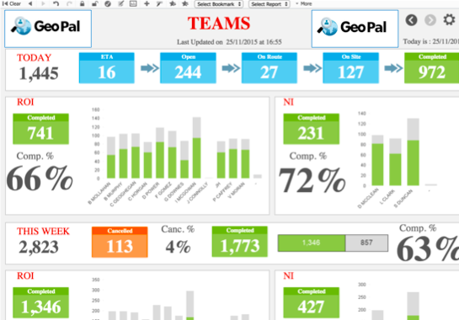
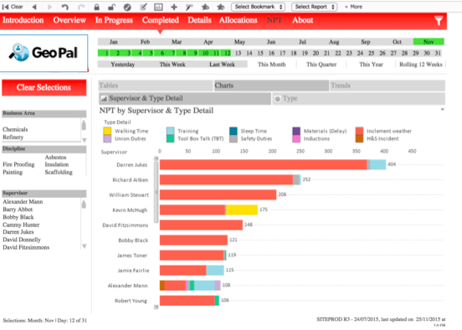
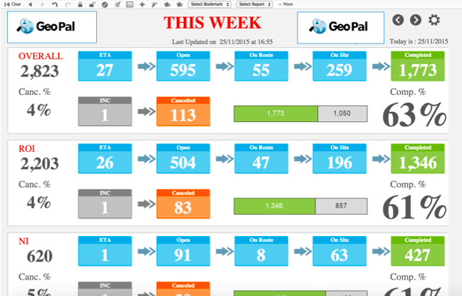
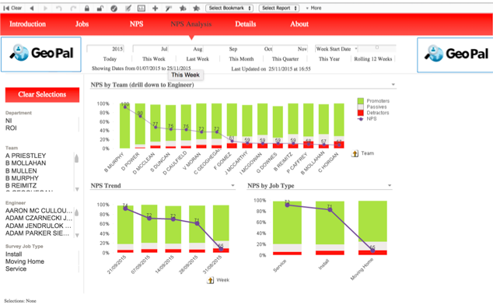
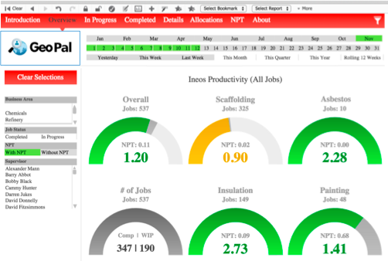
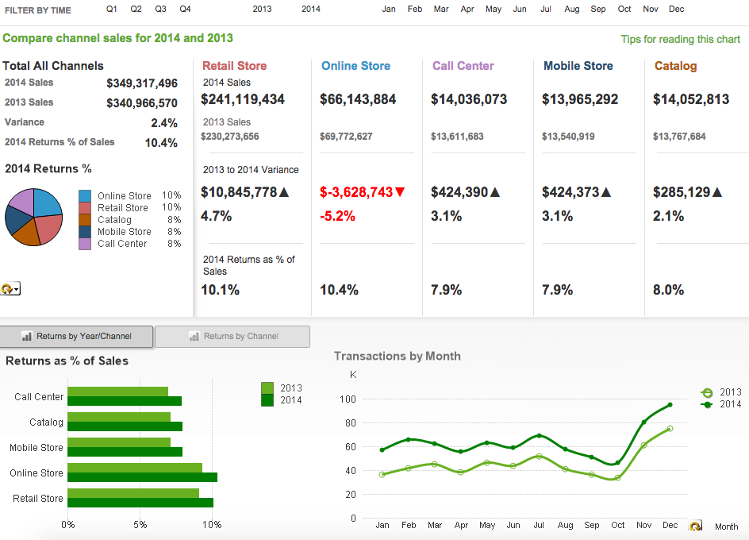
Example: Vending Machine
Sample of Dash Board Vending Metrics to be Monitored
Customised Reports providing KPIs (all from machine controller)
Electrical and Mechanical Metrics
  Energy usage and temperature
  Coin jam and tampering Alarms
  Coin box full (or partly full) and low on stock
  Power-offs
  Faults due to vandalism and theft
Financial Metrics
  Cash taken
  Field Stock levels
  Products sold and volumes
  Revenue region/machine

Slide 25
Example Transformer Buildings
Sample of Dash Board Vending Metrics to be Monitored
Customised Reports providing KPIs (all from machine controller)
Electrical and Mechanical Metrics
  Energy usage and temperature
  Security and Tampering Alarms
  Power-offs
  Faults due to vandalism and theft
Financial Metrics
  Asset Availability
  Building maintenance / security costs

Slide 26
Vending Machines with IoT / M2M
10% increase in driver productivity through efficient scheduling (1 person per 110 machines). Through IoT/ M2M scheduled driving routes.
50% reduction in admin costs through eliminating paper
100% compliance with H&S requirements
100% Revenue Assurance
100% Full Historical Reporting
100% Stock and Cash position
19% Increase in Asset Availability (*+RR)
14% increase in First Time Fix Rate
9% increase in Total Service Revenue
7% increase in Mean Time To Repair
4% increase in Mean Time Between Fails

Slide 27

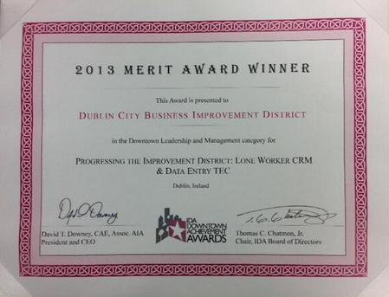
Award winning
The winner here was Geopal Solutions and the company's intelligent dispatch system that has so far received a very positive response from many customers. GeoPal's IoT-enabled mobility platform and intelligent job dispatch gives businesses with assets in the field the ability to eliminate expensive, reactive maintenance and leads a shift towards a proactive, preventative model of maintenance. With IoT sensors on assets, alarms are raised when assets go out of tolerance, but before they become faulty. These alarms can automatically trigger work orders that are sent to field technicians' mobile devices, maximising asset uptime.
Best IoT Technology Development:
Dublin City BID won a Merit Award in Downtown Leadership and Management at the 2013 IDA Awards.
The winning project uses GeoPal to improve the productivity of street ambassadors
and office staff, and reducing the cost of providing their service to Dublin Town.
“GeoPal has resulted in a 30% time saving for the
Ambassadors, so we have redirected that time to
visitor assistance. It has eliminated paperwork and
freed up administration resources for staff members
by 50%, it enables us to concentrate on marketing
activities both on and offline. This has been a
significant improvement for our overall strategy
and operating costs.” Clyde Carroll, Director, Dublin City BID

Slide 28

4.0 Worker Location Tracking
View the real-time location of workers ( not the vehicle )
See the jobs they are working on and the status of each job
Assigned jobs to the worker closest to the job location
See if the worker is logged in to the mobile app.

Slide 29
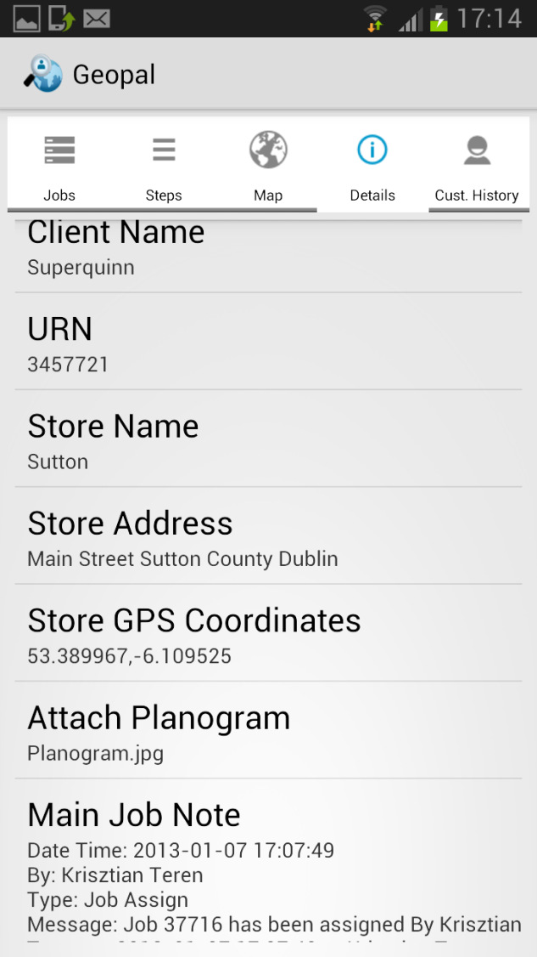
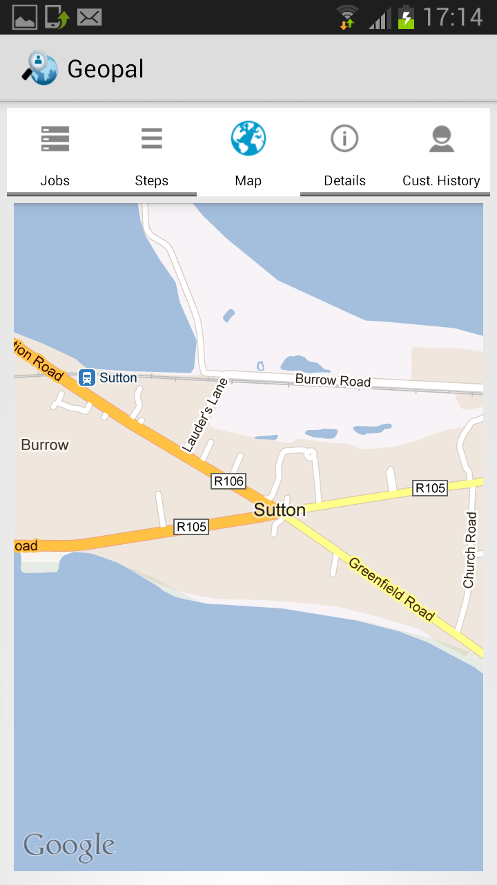

5.0 Step by Step Navigation
GPS and Address
Audio support
Live traffic conditions
Where to turn and which lane
More efficient routes.
If you get off track, Maps will automatically find a new route for you.
Estimated arrival time
The driver clicks on the GPS Coordinates or address to view the job Location and get turn by turn directions
1
2

Slide 30
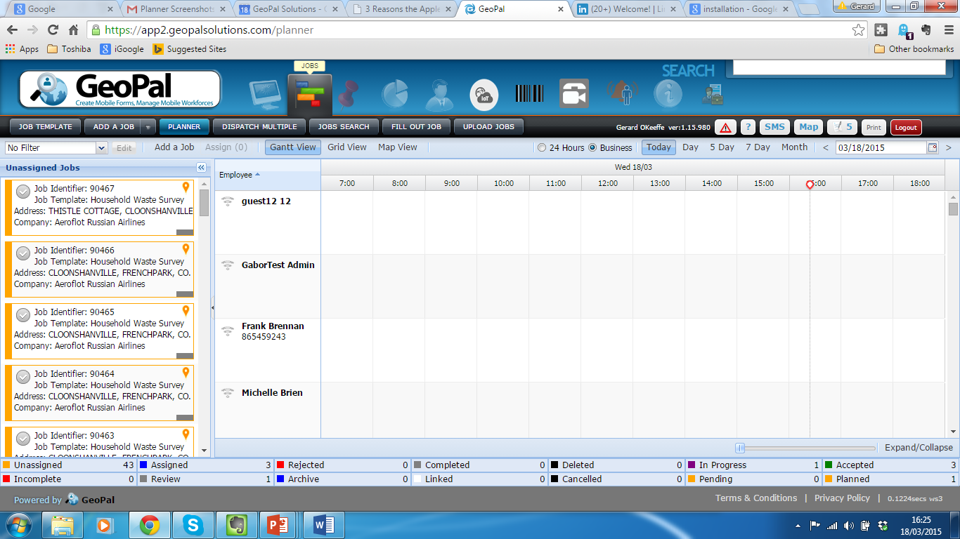
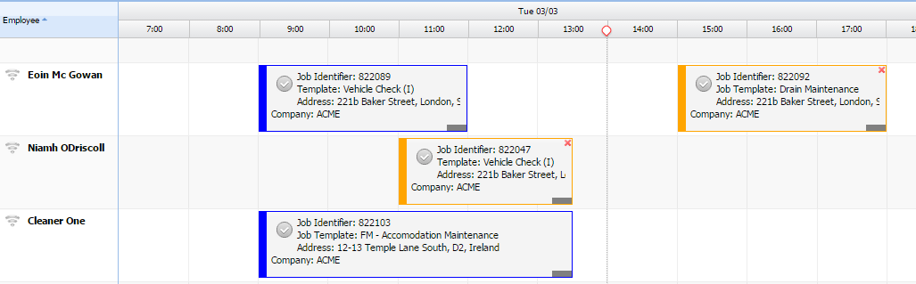

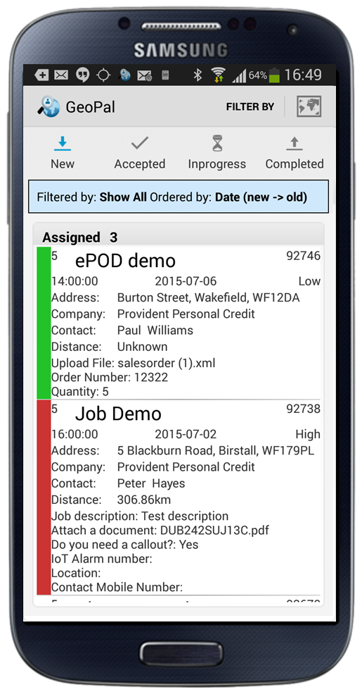
6.0 Job Scheduling and Dispatch
Simple drag and drop assignment of jobs
Different views available – planner, list, map view
Colours indicate different jobs statuses – accepted, in progress, completed, etc.
Worker receives all job details and workflow steps to be completed.
View, accept, and update job status directly

Slide 31
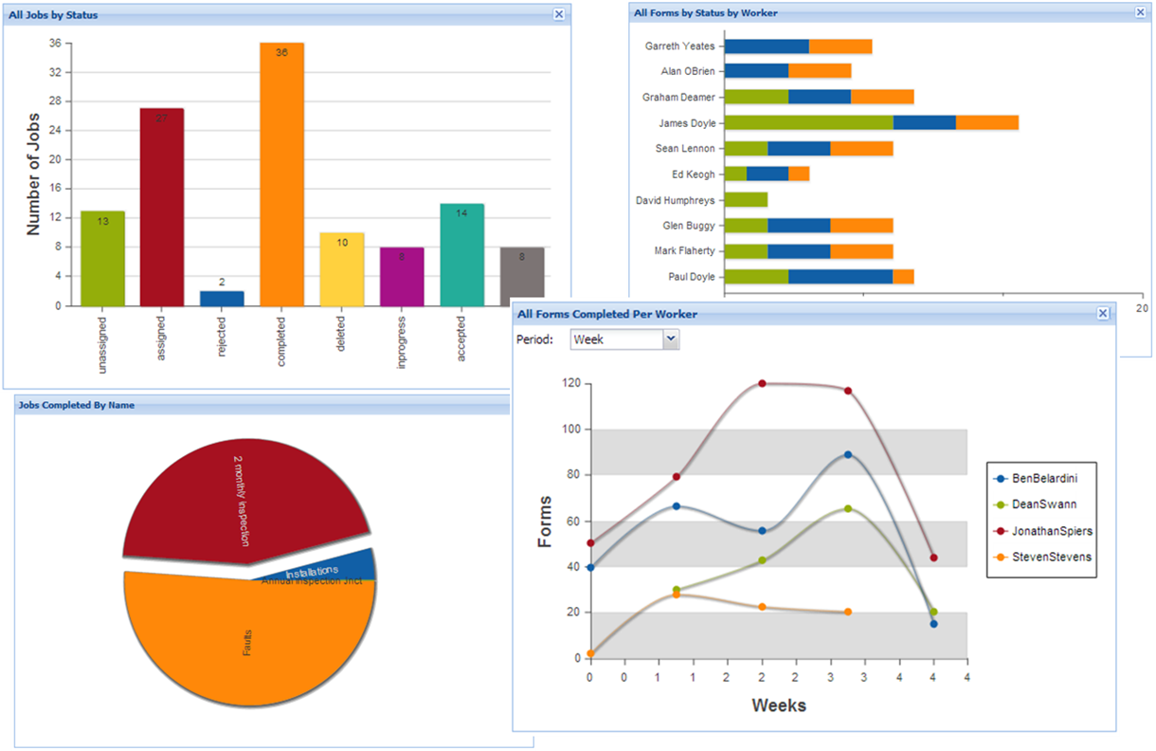
7.0 Custom Reports
Run standard reports
Create custom reports
Create pivot tables for analysis
Create heat maps and pin maps
Toggle between tabular and map views
Schedule delivery of reports via email – daily, weekly, monthly
Output in PDF, Excel, KML, XML, JSON formats.

Slide 32
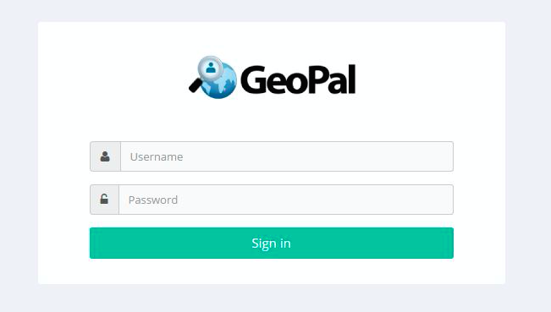
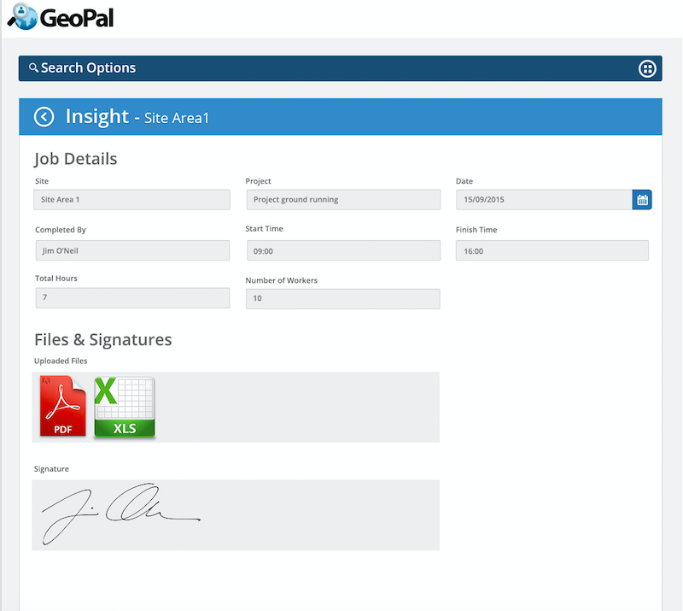
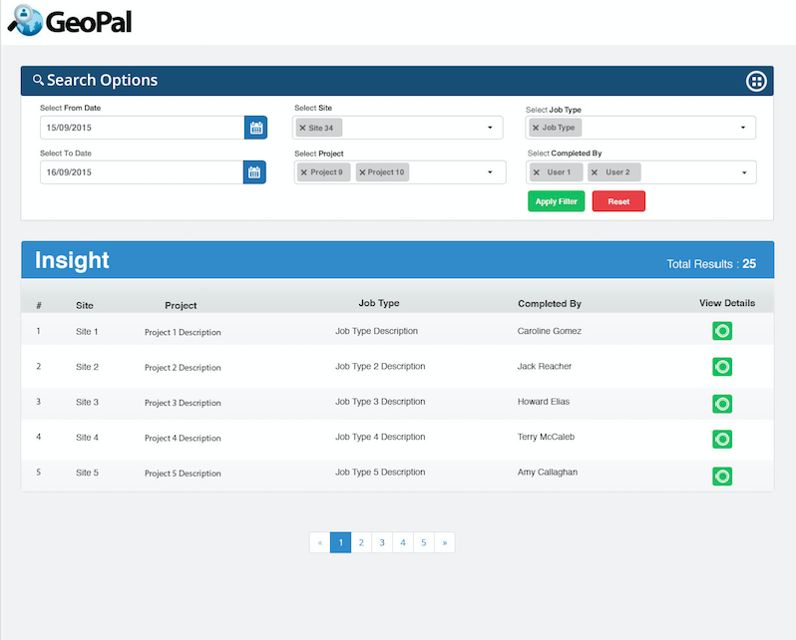
8.0 Customer Portal
Allow your customers to:
  Log in and see and report on work you are doing for them.
  Send requests for work to be done.
  Send comments on work done.
Customisable with customers Logo and colour scheme

Slide 33


9.0 Integration with Third Party Software
Integrate GeoPal with :
Finance systems : Sage, Quickpay, Freshbooks, Xero, etc
CRM : Microsoft Dynamics CRM Salesforce, SugarCRM, Zoho, etc
ERP : SAP Business 1, Microsoft Dynamics Nav, NetSuite, Sage, etc.

Slide 34
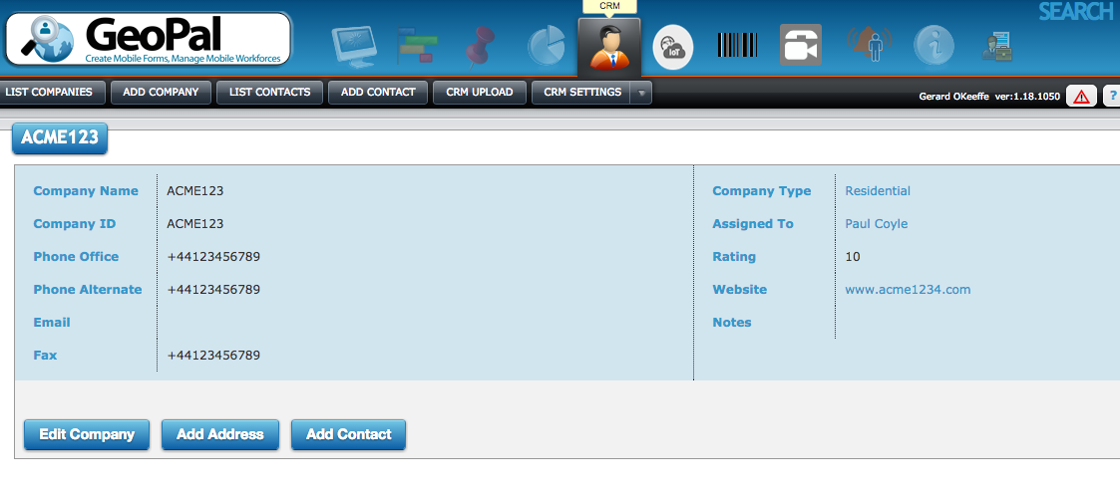
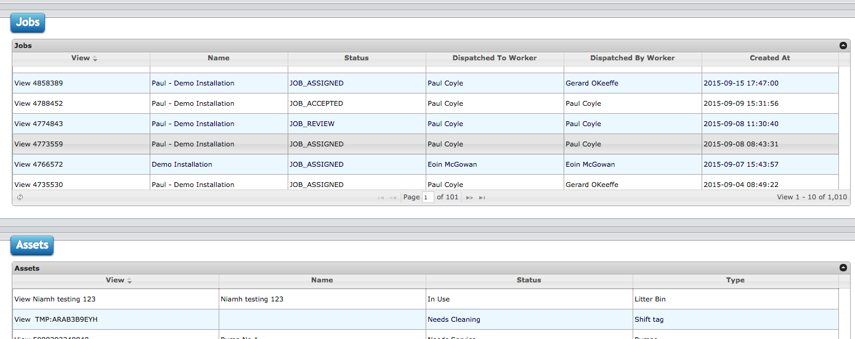

11 CRM
Log all contact details
See in one place all jobs undertaken for all locations over any period of time
Store any asset information for all locations
Add Extra field and notes as you require for example to categorise and classify your clients

Slide 35


12 Credit Card Payment
Accept and Process credit card payments in the field
Accept signatures with card
Use your own logo and colours

Slide 36
Main GeoPal Features
1.0 KPI and SLA Information/Analysis
2.0 Custom (Paperless) Job Workflows
  2.1 Remove paper
  2.2 Time and Materials Capture
  2.3 Proof of Attendance
  2.4 Capture order changes
  2.5 All Safety and Health Forms
3. Field Asset Management
4. Worker location tracking
5. Step by Step Navigation
6. Job Scheduling and Dispatch
7. On line real time Reports
8. Data Exchange to 3rd party s/w
9. Proactive Field Service (IoT/M2M)
10. Lone Worker Protection

Slide 37
Sample Executive Dashboard – Business Intelligence
Track 100s KPIs
Real time analysis aginst SLAs
Real time alerts (emails and SMS)
Very flexible, interact and navigate
Can be dynamically flexed : patterns, trends and correlations
Suitable for flexible analytical scenarios
Allows interpretation of data at a deeper level
Allows questioning, examining, interpreting, comparing, and confirming

Slide 38
Sample Public Body Use Cases
Environmental surveys
Traffic Management through IoT/M2M Module
Interconnect to GIS systems to display GIS information in the field
Housing Surveys
All field health and Safety checks
All vehicle checks
Building code control
Road Surveys
Water survey reports
Parking tickets
Credit Control
Field Payments

Slide 39

Dashboard Examples

Slide 40

Dashboard Examples

Slide 41

Dashboard Examples

Slide 42

Dashboard Examples

Slide 43

Dashboard Examples

