Slide 1
Smart Connected Cities
GeoPal Platform Overview

Slide 2
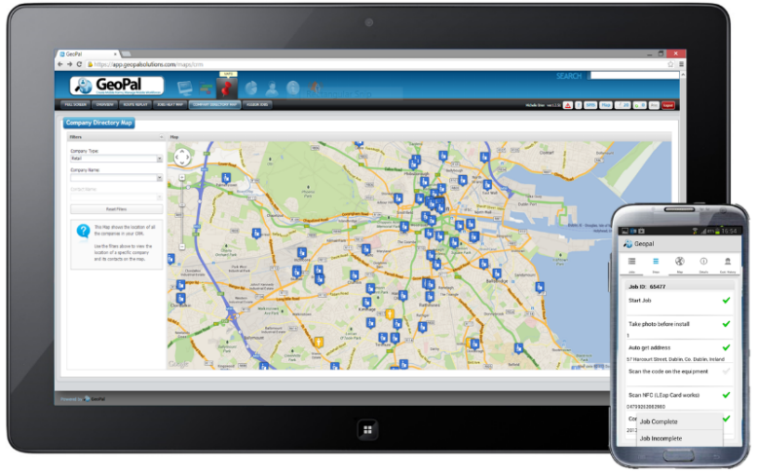

What is GeoPal?
GeoPal is a cloud service and mobile app for Public Sector bodies to cost effectively and smartly manage field operations.
Mobile data capture with photographs, time, date & location stamps
Job scheduling and dispatch with status tracking
Asset Management System with Map view functionality
Flexible IoT / M2M functionality
Seamless integration with CRM, GIS, or other IT systems
Health & Safety Legislation compliance with mobile forms for
Risk Assessment and Vehicle Roadworthiness Inspection Checks
Lone Worker Protection, panic alarm and still detection
Notes:
GeoPal’s mobile workforce management solutions
Simplify scheduling for your field-based workforce
Eliminate paperwork and reduce your admin costs
Improve visibility of employees and assets in the field
Increase accuracy of data collection and reporting
Enhance customer satisfaction with real-time proof of delivery
Help you to increase efficiency and cash flow
Provide protection for lone workers

Slide 3






































Some of our Customers

Slide 4
Problems Solved by GeoPal
Lack of key Information to drive productivity and efficiencies
Not meeting KPIs /SLAs
Revenue Assurance problems
Proof of Delivery Issues
Excessive penalties
Mileage Time and Material capture
Excess of Paper Forms
Market differentiation to win new business
No real-time job status
Lack of Visibility of Workers
Health & Safety Issues
Regular Vehicle Inspections
Field Asset Management
Inefficient Job Scheduling
Inefficient Navigation

Slide 5

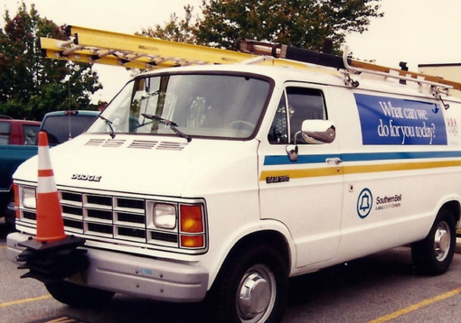


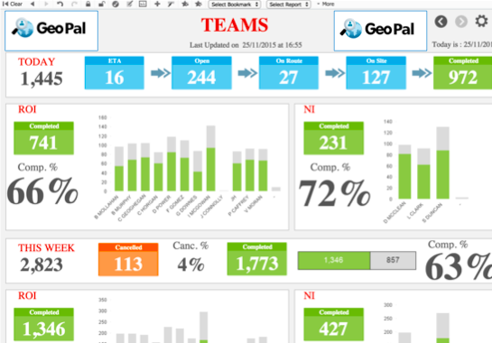
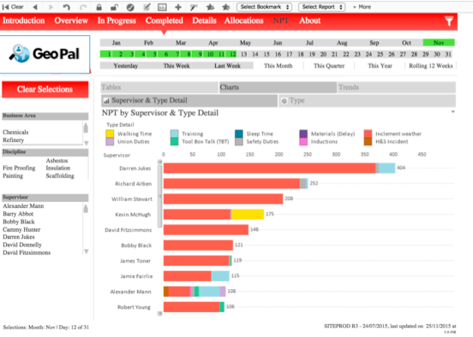
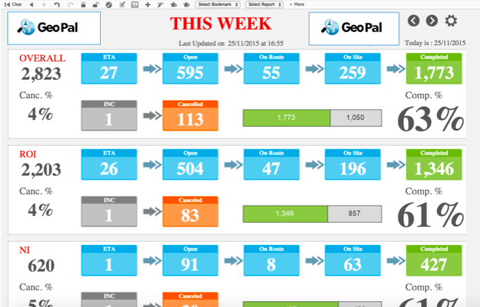
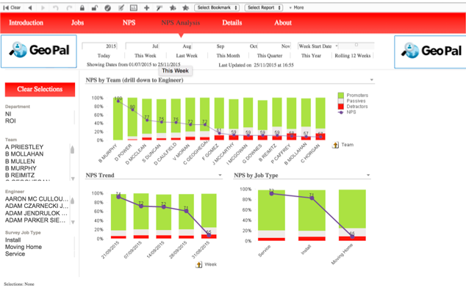


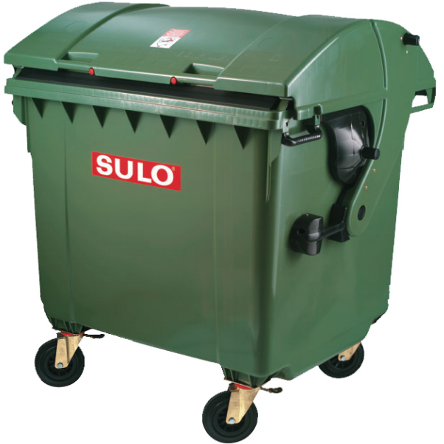



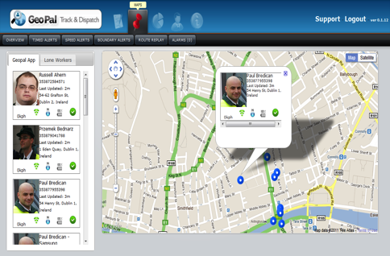
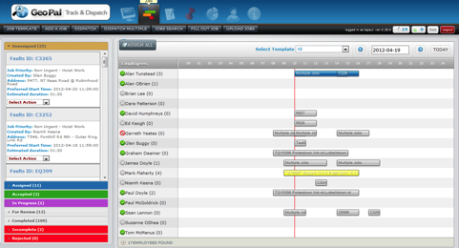



GeoPal Smart Field Service Platform
GeoPal Executive Dashboard Module
GeoPal Web Module
GeoPal Mobile App Module
GeoPal IoT /M2M Module
GeoPal API Connect Module

Slide 6






Value Proposition
Productivity
Efficiency
Proof of Work Done
Win new Business
Visibility
Productivity
Reduced Panalites .100% customizable, comprehensive reporting delivers greater transparency on KPIs and SLAs
Reduce Admin costs by 50% by eliminating paperwork. 100% on-line accurate real time reliable reporting. Full historical reporting and analytics
100% Revenue Assurance. Reduced risk. 100% proof of all work done and compliance with workflows and regulations
Up to 17% increase in field quotations, 80% decrease in invoice disputes; 3% increase in total service revenue; 100% handling of order changes
100% of visibility of staff when they leave the office. Accurate capture of mileage, time and materials. 100% tracking of job status and workflows
Up to 30% increase in operational savings through increased efficiency with IoT

Slide 7
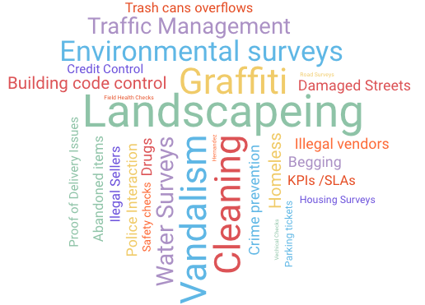
Areas Of Operation

Slide 8

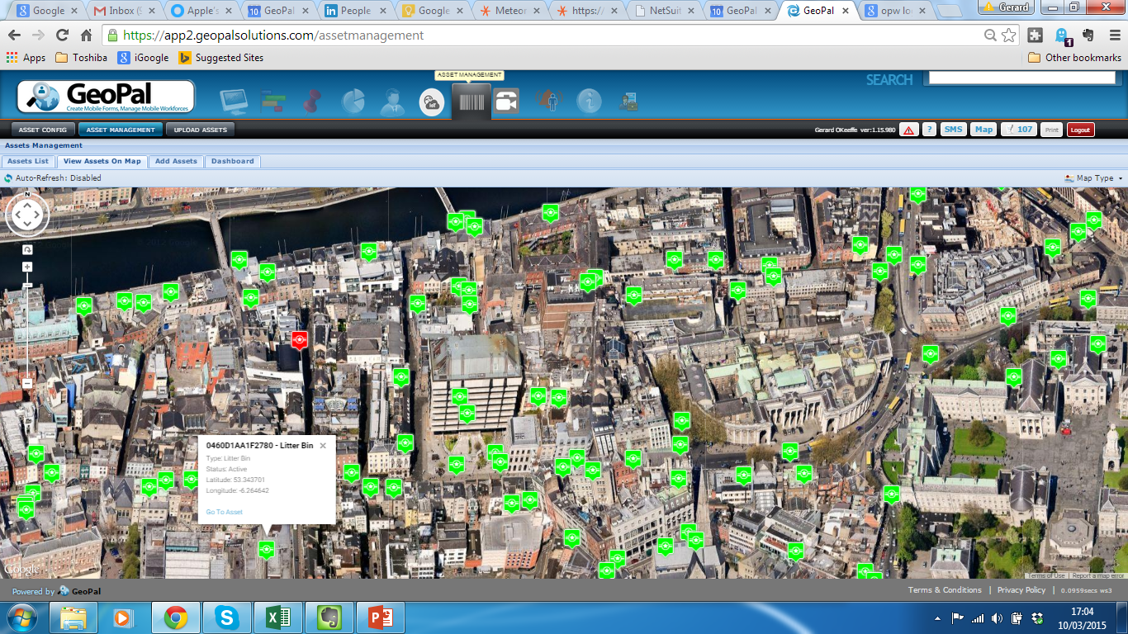
Success Story – Dublin City Council
Dublin City Council uses GeoPal for the following surveys :
Location and condition of litter bins
Reporting defective bins
Container / Compactor Surveys
Graffiti Removal jobs

Slide 9


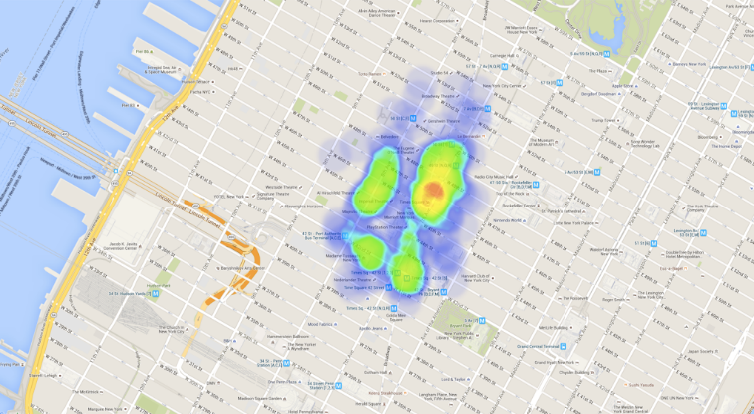
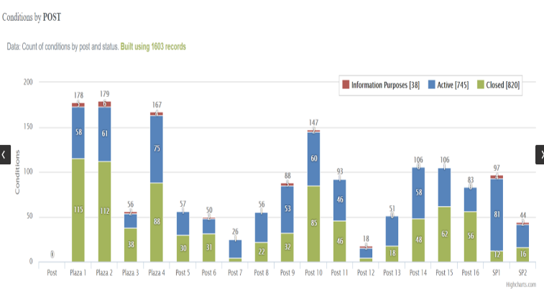
Times Square – New York
Paperless workforce management including health and safety compliance.
On-line real time reports across KPIs and SLAs
Heat-maps and full charting
Show proof of compliance and work completed to its stakeholders. Local businesses are more engaged and clearly see the benefits provided by Times Square Alliance’s services.
Asset management and condition tracking. Street officers can update the asset status and report faulty assets in real-time, enabling faster repairs. Sanitation division and external agencies receive jobs in real time.
Location and condition of litter bins
Reporting defective litter bins
Container / Compactor Surveys
Reporting and cleaning / removal of Graffiti
Interaction with Police and municipal 311 system

Slide 10



Sacramento City
Removing all field paper and logging all field staff activities
Accurate GPS tracking of staff and Assets
Efficiently scheduling and dispatching of work in the office for all internal clean and safe field staff and external 3rd party contractors
Management of interactions with local business via GeoPal CRM
Reporting any issues and helping homeless population
Automatic reporting of issues and jobs and interaction with Police and municipal 311 system
Calendar scheduling of field staff’s work

Slide 11


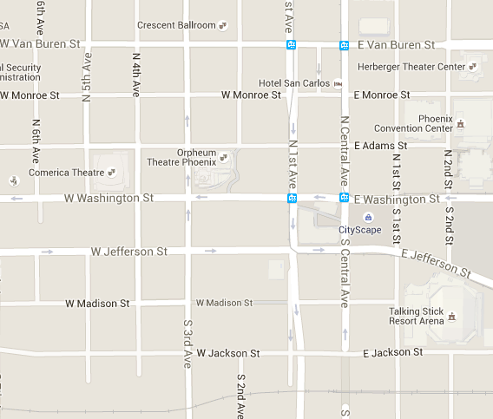
Phoenix City
Removing of all field paper and logging all field staff activities
Online real time reports of KPIs and SLAs
Efficiently scheduling and dispatching of work in the office for all field staff
Manage all staff in their Clean and Safe teams
Connect to internal ERP/CRM system
Manage 3rd party contractors, for example landscaping, infrastructure repairs and maintenance)
Real time reporting and connection between street work completed and individual businesses
Tracking all downtown events and banner reservations

Slide 12



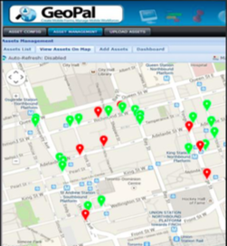
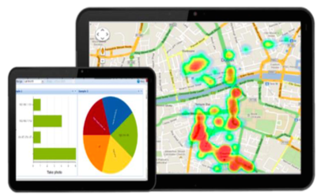
Toronto City
Removing all field paper. Managing all street jobs, for example Graffiti Removal jobs
Mangaing the Location and condition of all city assets. Reporting defective city and private assets
Real-time tracking of issues, resolution times, and 3rd-party agency service level agreements. Integration with municipal 311 systems ensures real-time reporting and progress tracking for all public realm assets.
Accurate tracking of compliance with agreed standards for resolution times, particularly in relation to work outsourced to 3rd party agencies or 311 systems for municipal services.
Planning of maintenance requests to enable more informed planning for future improvements.
Detailed reports with photos, times, and locations, as well as information regarding maintenance issues resolved, provide proof of the value created /delivered for stakeholders.

Slide 13

Success Story – Wexford City
Wexford County Council are using GeoPal for surveys, inspections, and lone worker protection across
a number of departments including Environment and Housing. Inspections include :
Bring Centre Inspection
Dangerous Structure Inspection
Derelict Site Inspection
Dumping and Dumping Cleanup
GeoPal has been integrated into the existing IT systems, including a CRM and an ArcGIS database, enabling Wexford County Council to securely and instantly transfer data and asset information captured in the field to their internal systems for analysis and reporting.
“Since we began using GeoPal our Environment team had observed a noticeable decrease in the turnaround times from when a call comes in from a member of the public to the time when the incident was closed. On investigation of our internal stats we found a 36% decrease in the time taken from receiving a call on an incident to closing it.”
Housing Annual Survey
Health & Safety Site Inspection
Vacant House Inspection
Parking Offence ticketing

Slide 14
Wexford Use Cases
H&S and facilities – Fire prevention equipment inspection , Photo record, Driver walk around inspections, confined spaces permit, GA3 – Working at height form, , Roof Access Permit.
Roads – Photo record, Road Traffic counts, our entire fleet management is done through GeoPal such as DOE, Service, Tax scheduled jobs using Asset Management
Building Control – Photo record
Access for All – Photo record
Environment – Environmental Cleanup Inspections, Playground Inspections, Park Inspections, Ring Buoy Inspections , Lone Worker Activity Log
Water – Chlorine readings, Sewerage and Water Connections, Water meter reading, Community Cleanups, Environment Incident Cleanups, ESB meter reading, Photo Record, Sludge Transport Record
Credit Control – For all public housing.
Housing – Housing Response Maintenance, Preplanned maintenance, Photo Records, Septic tank Inspections, Ladder and Scaffolding Inspections
Pay Parking – All towns.

Slide 15

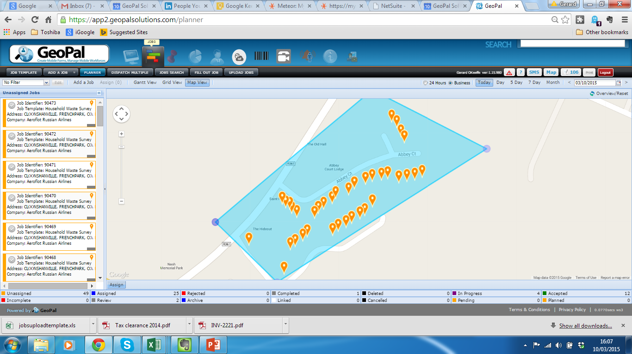
Success Story – Roscommon Town
Roscommon County Council are using GeoPal for the following surveys and inspections:
Cemetery Monument Records
Household Waste Surveys
Unauthorised Signs
WEEE and battery regulation
Vehicle Refinisher Inspection
Polygon selection of Household waste survey jobs

Slide 16

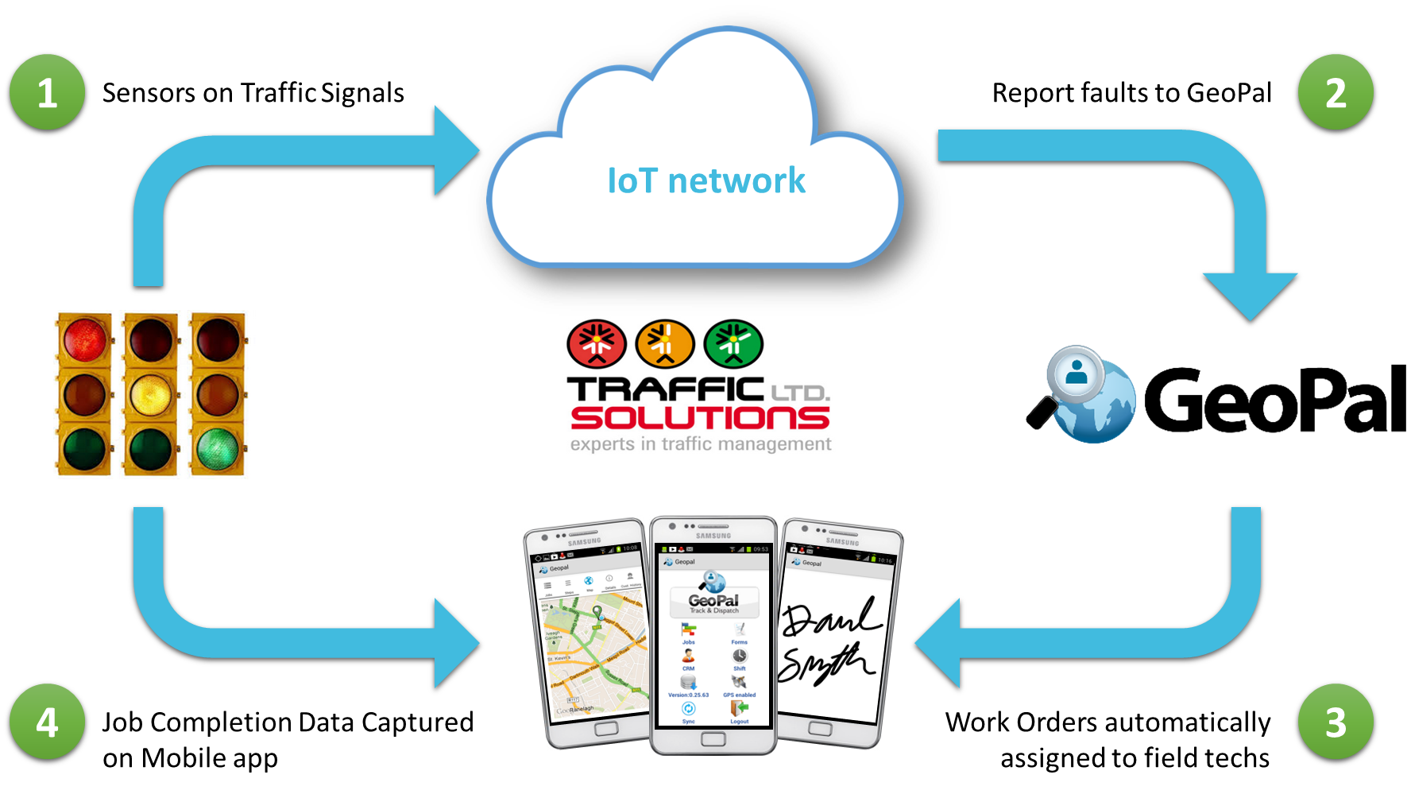
Success Story – Fingal Dublin
Dublin (Fingal) City are using GeoPal for Environmental Surveys and
Traffic Junction Fault Management

Slide 17
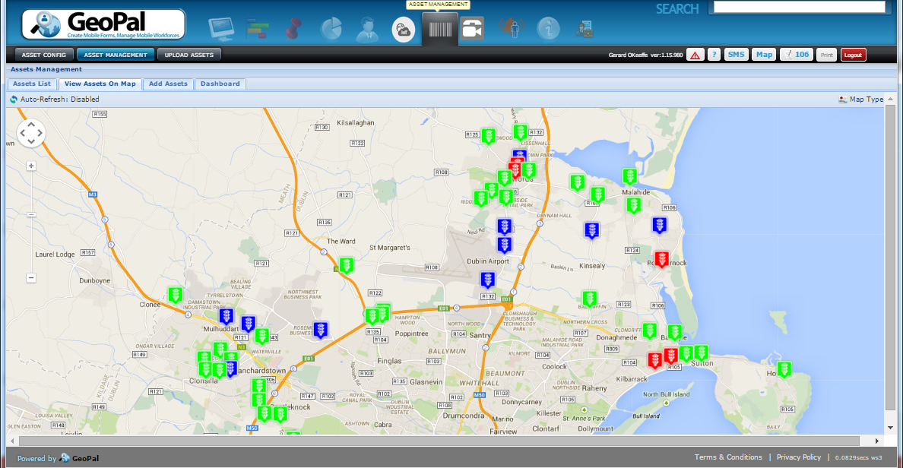
Success Story – Fingal County Council ….. continued
Map of Fingal County Council Traffic Junctions on GeoPal – showing real-time faults.

Slide 18
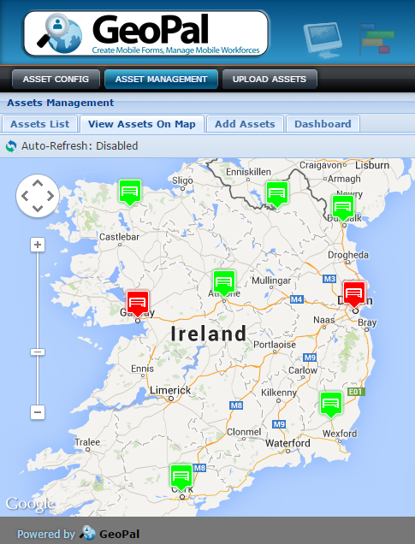

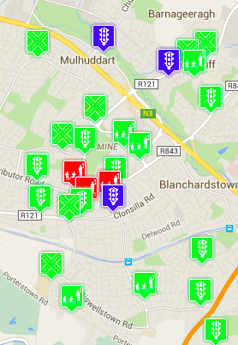



IoT / M2M Sensor Data Interface
Visualisation of Asset Status on GeoPal.
Asset Status updated by IoT sensors in the field.
Asset Jobs dispatched based on Rules entered in Rules Table.
Can cater for thousands of alarms per hour
IoT Sensors
GeoPal
IoT Alarms
Rules
Table
Mobile
Data Network
Or Other

Slide 19
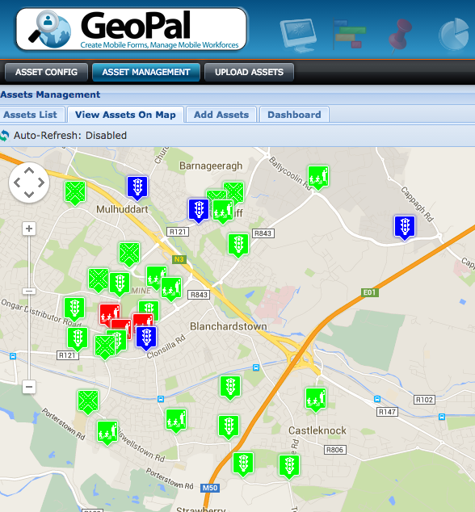
IoT / M2M - Field Asset Management
Register all field assets
Set up service and maintenance schedules
Visualisation of Asset Status on GeoPal.
Asset Status updated by IoT/M2M sensors in the field.
Asset Jobs dispatched based on Rules entered in Rules Table

Slide 20
Road Infrastructure use cases
Toilet usage /
People counter
Lay-by usage detection
Smart lighting / faults
Lay-by Bin Level
Detection
Signage control / monitoring
Movement of animals
Traffic Flow / Incident
detection

Slide 21

Connected Field Service – use cases
Temperature monitoring of refrigeration equipment
Detecting door
opening
Detecting Coin jams, faults, stock levels
Remote meter
reading
Monitoring flow rates and filter condition ( pressure )
Monitoring of
HVAC units

Slide 22
Smart Facility Management – use cases
Washroom people counter
Bin level sensors
Defibrillator usage
Wireless service request button

